Slide 1
Oracle Database 19c Security
Database Security

Slide 2
Introduction
Database Users and Schemas
Security domain
Actions
Quotas
System resources
Notes:
Database security entails allowing or disallowing user actions on the database and the objects within it. Oracle uses schemas and security domains to control access to data and to restrict the use of various database resources.
Oracle provides comprehensive discretionary access control. Discretionary access control regulates all user access to named objects through privileges. A privilege is permission to access a named object in a prescribed manner; for example, permission to query a table. Privileges are granted to users at the discretion of other users.
Database Users and Schemas
Each Oracle database has a list of user names. To access a database, a user must use a database application and attempt a connection with a valid user name of the database. Each user name has an associated password to prevent unauthorized use.
Security Domain
Each user has a security domain—a set of properties that determine such things as:
The actions (privileges and roles) available to the user
The tablespace quotas (available disk space) for the user
The system resource limits (for example, CPU processing time) for the user
Each property that contributes to a user's security domain is discussed in the following sections.

Slide 3
Privileges
A privilege is a right to run a particular type of SQL statement. Some examples of privileges include the right to:
Connect to the database (create a session)
Create a table in your schema
Select rows from someone else's table
Run someone else's stored procedure

Slide 4
Roles
Oracle provides for easy and controlled privilege management through roles.
Roles are named groups of related privileges that you grant to users or other roles.

Slide 5
Quotas and Settings
Default Table Space
TemporaryTablespace
Tablespace Quotas
Profiles and Resource Limits
Notes:
Storage Settings and Quotas
You can direct and limit the use of disk space allocated to the database for each user, including default and temporary tablespaces and tablespace quotas.
Default Tablespace
Each user is associated with a default tablespace. When a user creates a table, index, or cluster and no tablespace is specified to physically contain the schema object, the user's default tablespace is used if the user has the privilege to create the schema object and a quota in the specified default tablespace. The default tablespace provides Oracle with information to direct space use in situations where schema object's location is not specified.
Temporary Tablespace
Each user has a temporary tablespace. When a user runs a SQL statement that requires the creation of temporary segments (such as the creation of an index), the user's temporary tablespace is used. By directing all users' temporary segments to a separate tablespace, the temporary tablespace can reduce I/O contention among temporary segments and other types of segments.
Tablespace Quotas
Oracle can limit the collective amount of disk space available to the objects in a schema. Quotas (space limits) can be set for each tablespace available to a user. This permits selective control over the amount of disk space that can be consumed by the objects of specific schemas.
Profiles and Resource Limits
Each user is assigned a profile that specifies limitations on several system resources available to the user, including the following:
Number of concurrent sessions the user can establish
CPU processing time available for the user's session and a single call to Oracle made by a SQL statement
Amount of logical I/O available for the user's session and a single call to Oracle made by a SQL statement
Amount of idle time available for the user's session
Amount of connect time available for the user's session
Password restrictions:
Account locking after multiple unsuccessful login attempts
Password expiration and grace period
Password reuse and complexity restrictions

Slide 6
Transparent Data Encryption
Who owns the encryption?
Security or DBA?
Notes:
Overview of Transparent Data Encryption
The Oracle database provides security in the form of authentication, authorization, and auditing. Authentication ensures that only legitimate users gain access to the system. Authorization ensures that those users only have access to resources they are permitted to access. Auditing ensures accountability when users access protected resources. Although these security mechanisms effectively protect data in the database, they do not prevent access to the operating system files where the data is stored. Transparent data encryption enables encryption of sensitive data in database columns as it is stored in the operating system files. In addition, it provides for secure storage and management of encryption keys in a security module external to the database.
Using an external security module separates ordinary program functions from those that pertain to security, such as encryption. Consequently, it is possible to divide administration duties between DBAs and security administrators, a strategy that enhances security because no administrator is granted comprehensive access to data. External security modules generate encryption keys, perform encryption and decryption, and securely store keys outside of the database.
Transparent data encryption is a key-based access control system that enforces authorization by encrypting data with a key that is kept secret. There can be only one key for each database table that contains encrypted columns regardless of the number of encrypted columns in a given table. Each table's column encryption key is, in turn, encrypted with the database server's master key. No keys are stored in the database. Instead, they are stored in an Oracle wallet, which is part of the external security module.
Before you can encrypt any database columns, you must generate or set a master key. This master key is used to encrypt the column encryption key which is generated automatically when you issue a SQL command with the ENCRYPT clause on a database column.

Slide 7
Authentication Methods
Authentication by the Operating System
Authentication by the Network
Authentication by the Oracle Database
Multitier Authentication and Authorization
Authentication by the Secure Socket Layer Protocol
Authentication of Database Administrators
Authentication by the Operating
Notes:
Overview of Authentication Methods
Authentication means verifying the identity of someone (a user, device, or other entity) who wants to use data, resources, or applications. Validating that identity establishes a trust relationship for further interactions. Authentication also enables accountability by making it possible to link access and actions to specific identities. After authentication, authorization processes can allow or limit the levels of access and action permitted to that entity.
For simplicity, the same authentication method is generally used for all database users, but Oracle allows a single database instance to use any or all methods. Oracle requires special authentication procedures for database administrators, because they perform special database operations. Oracle also encrypts passwords during transmission to ensure the security of network authentication.
To validate the identity of database users and prevent unauthorized use of a database user name, you can authenticate using any combination of the methods described in the following sections:

Slide 8
OS Authentication
Once authenticated by the operating system, users can connect to Oracle more conveniently, without specifying a user name or password.
For example, an operating-system-authenticated user can invoke SQL*Plus and skip the user name and password prompts by entering the following:
SQLPLUS /
Notes:
Authentication by the Operating System
Some operating systems let Oracle use information they maintain to authenticate users, with the following benefits:
Once authenticated by the operating system, users can connect to Oracle more conveniently, without specifying a user name or password. For example, an operating-system-authenticated user can invoke SQL*Plus and skip the user name and password prompts by entering the following:
SQLPLUS /
With control over user authentication centralized in the operating system, Oracle need not store or manage user passwords, though it still maintains user names in the database.
Audit trails in the database and operating system use the same user names.
When an operating system is used to authenticate database users, managing distributed database environments and database links requires special care.

Slide 9
Network Authentication
Third Party-Based Authentication Technologies
Public-Key-Infrastructure-Based Authentication
Remote Authentication
Notes:
Third Party-Based Authentication Technologies
If network authentication services are available to you (such as DCE, Kerberos, or SESAME), then Oracle can accept authentication from the network service. If you use a network authentication service, then some special considerations arise for network roles and database links.
Public-Key-Infrastructure-Based Authentication
Authentication systems based on public key cryptography issue digital certificates to user clients, which use them to authenticate directly to servers in the enterprise without directly involving an authentication server. Oracle provides a public key infrastructure (PKI) for using public keys and certificates, consisting of the following components:
Authentication and secure session key management using Secure Sockets Layer (SSL).
Oracle Call Interface (OCI) and PL/SQL functions to sign user-specified data using a private key and certificate, and verify the signature on data using a trusted certificate.
Trusted certificates, identifying third-party entities that are trusted as signers of user certificates when an identity is being validated as the entity it claims to be.
Oracle wallets, which are data structures that contain a user private key, a user certificate, and the user's set of trust points (trusted certificate authorities).
Oracle Wallet Manager, a standalone Java application used to manage and edit the security credentials in Oracle wallets.
X.509v3 certificates obtained from (and signed by) a trusted entity, a certificate authority outside of Oracle.
Oracle Internet Directory to manage security attributes and privileges for users, including users authenticated by X.509 certificates. It enforces attribute-level access control and enables read, write, or update privileges on specific attributes to be restricted to specific named users, such as administrators.
Oracle Enterprise Security Manager, provides centralized privilege management to make administration easier and increase your level of security. This lets you store and retrieve roles from Oracle Internet Directory.
Oracle Enterprise Login Assistant, a Java-based tool to open and close a user wallet to enable or disable secure SSL-based communications for an application.
Remote Authentication
Oracle supports remote authentication of users through Remote Dial-In User Service (RADIUS), a standard lightweight protocol used for user authentication, authorization, and accounting.

Slide 10
Oracle DB Authentication
Password Encryption
Account Locking
Password Lifetime and Expiration
Password Complexity Verification
Notes:
Authentication by the Oracle Database
Oracle can authenticate users attempting to connect to a database by using information stored in that database.
To set up Oracle to use database authentication, create each user with an associated password that must be supplied when the user attempts to establish a connection. This prevents unauthorized use of the database, since the connection will be denied if the user provides an incorrect password. Oracle stores a user's password in the data dictionary in an encrypted format to prevent unauthorized alteration, but a user can change the password at any time.
Database authentication includes the following facilities:
Password Encryption
Account Locking
Password Lifetime and Expiration
Password Complexity Verification
Password Encryption
To protect password confidentiality, Oracle always encrypts passwords before sending them over the network. Oracle encrypts the passwords using a modified AES (Advanced Encryption Standard) algorithm.
Account Locking
Oracle can lock a user's account after a specified number of consecutive failed log-in attempts. You can configure the account to unlock automatically after a specified time interval or to require database administrator intervention to be unlocked. The database administrator can also lock accounts manually, so that they must be unlocked explicitly by the database administrator.
Password Lifetime and Expiration
The database administrator can specify a lifetime for passwords, after which they expire and must be changed before account login is again permitted. A grace period can be established, during which each attempt to login to the database account receives a warning message to change the password. If it is not changed by the end of that period, then the account is locked. No further logins to that account are allowed without assistance by the database administrator.
The database administrator can also set the password state to expired, causing the user's account status to change to expired. The user or the database administrator must then change the password before the user can log in to the database.
The password history option checks each newly specified password to ensure that a password is not reused for a specified amount of time or for a specified number of password changes.
Password Complexity Verification
Complexity verification checks that each password is complex enough to provide reasonable protection against intruders who try to break into the system by guessing passwords.
The Oracle default password complexity verification routine checks that each password meet the following requirements:
Be a minimum of four characters in length
Not equal the userid
Include at least one alphabet character, one numeric character, and one punctuation mark
Not match any word on an internal list of simple words like welcome, account, database, user, and so on
Differ from the previous password by at least three characters

Slide 11
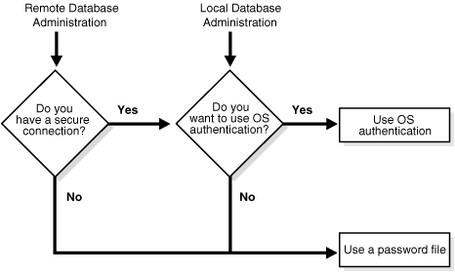
Multitier Authentication and Authorization
Notes:
In a multitier environment, Oracle controls the security of middle-tier applications by limiting their privileges, preserving client identities through all tiers, and auditing actions taken on behalf of clients. In applications that use a heavy middle tier, such as a transaction processing monitor, the identity of the client connecting to the middle tier must be preserved. Yet one advantage of a middle tier is connection pooling, which allows multiple users to access a data server without each of them needing a separate connection. In such environments, you must be able to set up and break down connections very quickly.
For these environments, Oracle database administrators can use the Oracle Call Interface (OCI) to create lightweight sessions, allowing database password authentication for each user. This preserves the identity of the real user through the middle tier without the overhead of a separate database connection for each user.
You can create lightweight sessions with or without passwords. However, if a middle tier is outside or on a firewall, then security is better when each lightweight session has its own password. For an internal application server, lightweight sessions without passwords might be appropriate.
Authentication by the Secure Socket Layer Protocol
The Secure Socket Layer (SSL) protocol is an application layer protocol. Users identified either externally or globally (external or global users) can authenticate to a database through SSL.
Authentication of Database Administrators
Database administrators perform special operations (such as shutting down or starting up a database) that should not be performed by normal database users. Oracle provides a more secure authentication scheme for database administrator user names.
You can choose between operating system authentication or password files to authenticate database administrators. Figure 20-1 illustrates the choices you have for database administrator authentication schemes. Different choices apply to administering your database locally (on the computer where the database resides) and to administering many different database computers from a single remote client.
Operating system authentication for a database administrator typically involves placing his operating system user name in a special group or giving it a special process right. (On UNIX systems, the group is the dba group.)
The database uses password files to keep track of database user names that have been granted the SYSDBA and SYSOPER privileges, enabling the following operations:
SYSOPER lets database administrators perform STARTUP, SHUTDOWN, ALTER DATABASE OPEN/MOUNT, ALTER DATABASE BACKUP, ARCHIVE LOG, and RECOVER, and includes the RESTRICTED SESSION privilege.
SYSDBA contains all system privileges with ADMIN OPTION, and the SYSOPER system privilege. Permits CREATE DATABASE and time-based recovery.

Slide 12
Authorization
Permitting only certain users to access, process, or alter data
Applying varying limitations on users' access or actions. The limitations placed on (or removed from) users can apply to objects, such as schemas, tables, or rows; or to resources, such as time (CPU, connect, or idle times).
Notes:
Authorization primarily includes two processes:
Permitting only certain users to access, process, or alter data
Applying varying limitations on users' access or actions. The limitations placed on (or removed from) users can apply to objects, such as schemas, tables, or rows; or to resources, such as time (CPU, connect, or idle times).
This section introduces the basic concepts and mechanisms for placing or removing such limitations on users, individually or in groups.

Slide 13
User Resource Limits and Profiles
Types of System Resources and Limits
Profiles
Notes:
You can set limits on the amount of various system resources available to each user as part of a user's security domain. By doing so, you can prevent the uncontrolled consumption of valuable system resources such as CPU time.
This is very useful in large, multiuser systems, where system resources are expensive. Excessive consumption of resources by one or more users can detrimentally affect the other users of the database.
Manage a user's resource limits and password management preferences with his or her profile—a named set of resource limits that you can assign to that user. Each database can have an unlimited number of profiles. The security administrator can enable or disable the enforcement of profile resource limits universally.
If you set resource limits, then a slight degradation in performance occurs when users create sessions. This is because Oracle loads all resource limit data for the user when a user connects to a database.

Slide 14
Types of System Resources and Limits
Session Level
Call Level
CPU Time
Logical Reads
Notes:
Types of System Resources and Limits
Oracle can limit the use of several types of system resources, including CPU time and logical reads. In general, you can control each of these resources at the session level, the call level, or both.
Session Level
Each time a user connects to a database, a session is created. Each session consumes CPU time and memory on the computer that runs Oracle. You can set several resource limits at the session level.
If a user exceeds a session-level resource limit, then Oracle terminates (rolls back) the current statement and returns a message indicating that the session limit has been reached. At this point, all previous statements in the current transaction are intact, and the only operations the user can perform are COMMIT, ROLLBACK, or disconnect (in this case, the current transaction is committed). All other operations produce an error. Even after the transaction is committed or rolled back, the user can accomplish no more work during the current session.
Call Level
Each time a SQL statement is run, several steps are taken to process the statement. During this processing, several calls are made to the database as part of the different execution phases. To prevent any one call from using the system excessively, Oracle lets you set several resource limits at the call level.
If a user exceeds a call-level resource limit, then Oracle halts the processing of the statement, rolls back the statement, and returns an error. However, all previous statements of the current transaction remain intact, and the user's session remains connected.
CPU Time
When SQL statements and other types of calls are made to Oracle, an amount of CPU time is necessary to process the call. Average calls require a small amount of CPU time. However, a SQL statement involving a large amount of data or a runaway query can potentially consume a large amount of CPU time, reducing CPU time available for other processing.
To prevent uncontrolled use of CPU time, limit the CPU time for each call and the total amount of CPU time used for Oracle calls during a session. Limits are set and measured in CPU one-hundredth seconds (0.01 seconds) used by a call or a session.
Logical Reads
Input/output (I/O) is one of the most expensive operations in a database system. SQL statements that are I/O intensive can monopolize memory and disk use and cause other database operations to compete for these resources.
To prevent single sources of excessive I/O, Oracle lets you limit the logical data block reads for each call and for each session. Logical data block reads include data block reads from both memory and disk. The limits are set and measured in number of block reads performed by a call or during a session.
Other Resources
Oracle also provides for the limitation of several other resources at the session level:
You can limit the number of concurrent sessions for each user. Each user can create only up to a predefined number of concurrent sessions.
You can limit the idle time for a session. If the time between Oracle calls for a session reaches the idle time limit, then the current transaction is rolled back, the session is aborted, and the resources of the session are returned to the system. The next call receives an error that indicates the user is no longer connected to the instance. This limit is set as a number of elapsed minutes.
Shortly after a session is aborted because it has exceeded an idle time limit, the process monitor (PMON) background process cleans up after the aborted session. Until PMON completes this process, the aborted session is still counted in any session/user resource limit.
You can limit the elapsed connect time for each session. If a session's duration exceeds the elapsed time limit, then the current transaction is rolled back, the session is dropped, and the resources of the session are returned to the system. This limit is set as a number of elapsed minutes.
Oracle does not constantly monitor the elapsed idle time or elapsed connection time. Doing so would reduce system performance. Instead, it checks every few minutes. Therefore, a session can exceed this limit slightly (for example, by five minutes) before Oracle enforces the limit and aborts the session.
You can limit the amount of private SGA space (used for private SQL areas) for a session. This limit is only important in systems that use the shared server configuration. Otherwise, private SQL areas are located in the PGA. This limit is set as a number of bytes of memory in an instance's SGA. Use the characters K or M to specify kilobytes or megabytes.

Slide 15
Profiles
When to use profiles
Values for Resource Limits
Notes:
Profiles
In the context of system resources, a profile is a named set of specified resource limits that can be assigned to a valid user name in an Oracle database. Profiles provide for easy management of resource limits. Profiles are also the way in which you administer password policy.
Different profiles can be created and assigned individually to each user of the database. A default profile is present for all users not explicitly assigned a profile. The resource limit feature prevents excessive consumption of global database system resources.
When to Use Profiles
You need to create and manage user profiles only if resource limits are a requirement of your database security policy. To use profiles, first categorize the related types of users in a database. Just as roles are used to manage the privileges of related users, profiles are used to manage the resource limits of related users. Determine how many profiles are needed to encompass all types of users in a database and then determine appropriate resource limits for each profile.
Determine Values for Resource Limits of a Profile
Before creating profiles and setting the resource limits associated with them, determine appropriate values for each resource limit. You can base these values on the type of operations a typical user performs. Usually, the best way to determine the appropriate resource limit values for a given user profile is to gather historical information about each type of resource usage.
You can gather statistics for other limits using the Monitor feature of Oracle Enterprise Manager (or SQL*Plus), specifically the Statistics monitor.

Slide 17
Oracle 19c Security
Agenda
Day 1)
Understand basic Oracle security solution
Creating basic Oracle users
Introduction into new Oracle sys accounts
Day 2)
Configure strong database authentication
Control access using Oracle Label Security
Assign database privileges
Day 3)
Introduction to Oracle’s Database Vault
Introduction into Data Redaction
Introduction into Transparent Data Encryption (TDE)

Slide 18
Oracle 19c Security
Agenda
Day 4)
Introduction into Data Masking
Audit Database activity
Oracle’s network security
Day 5)
Oracle’s database roles and proxies
Security using PL/SQL
Definers rights and Invokers rights
Remap data using datapump

Slide 19
Creating a password profile
You'll need an existing user who has create profile privilege. Also, you'll need an unlocked user account.
Make sure that the resource_limit parameter is set to true.
Notes:
(such as an OS-authenticated user who has database administrators (dba) role, for example, ops$ernesto).

Slide 20
Creating a password profile
Use OS authentication to connect to the database.
Create a password profile with the name userprofile that has the following restrictions:
Assign a newly created password profile to the user.
Alter the default password profile with the failed_login_attempts restriction.
The system allows four login attempts before locking a user account (failed_login_attempts)
After locking a user account, it will remain locked for two days (password_lock_time)
A password for the user can remain unchanged for 180 days - after which the password will expire, and the user will have to change the password for his next login (password_life_time)
Notes:
If we don't assign a password profile to the user, that user uses the default password profile.

Slide 21
Creating a password profile
In Oracle Database 19c, there are three password verify functions:
If password complexity checking is not enabled, you should run the utlpwdmg.sql script provided by Oracle.
If you want to choose which verify function will be used in the default profile:
verify_function_11G (carried over)
ora19c_verify_function (new)
ora19c_strong_verify_function (new)
alter profile default limit password_verify_function ora19c_strong_verify_function;
Notes:
Password complexity: It's located in $ORACLE_HOME/rdbms/admin. The ora19c_verify_function is the default that the utlpwdmg.sql script uses.
Password complexity checking, even when enabled, doesn't apply to sys user.

Slide 22
Creating password-authenticated users
You'll need an existing user who has create user privilege.
You'll use Oracle Enterprise Manager Database Express 19c (EM Express).
Notes:
(you may use the OS-authenticated user who has the DBA role).

Slide 23
Creating password-authenticated users
Use OS authentication to connect to the database.
Create a password-authenticated user jessica with simpler password.
Create a password-authenticated user tom with more complex password.
Both of these users are using the default password profile.
Create a password-authenticated user with the assigned password profile userprofile.

Slide 24
Creating password-authenticated users
Create user john. This user has to change his password at the first database login.
Create the user richard. In the create user statement, quota unlimited on users means that you want to let the user allocate space in the tablespace without bound.
Notes:
The quota clause lets you define the maximum amount of space the user can allocate in the tablespace. You can have multiple quota clauses for multiple tablespaces within one create user statement. The unlimited tablespace system privilege enables users to have an unlimited quota on all tablespaces in the database.

Slide 25
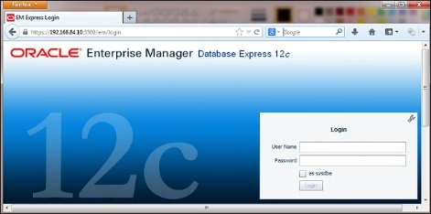
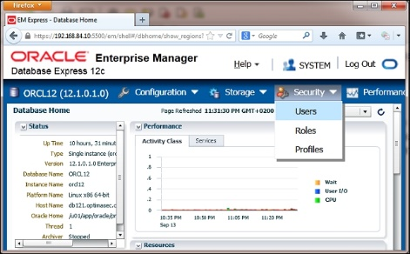
How to create a user using EM Express
Start EM Express and log in to it using the user that has either EM_EXPRESS_BASIC or EM_EXPRESS_ALL role
1
Select Users from the Security drop-down menu
2

Slide 26
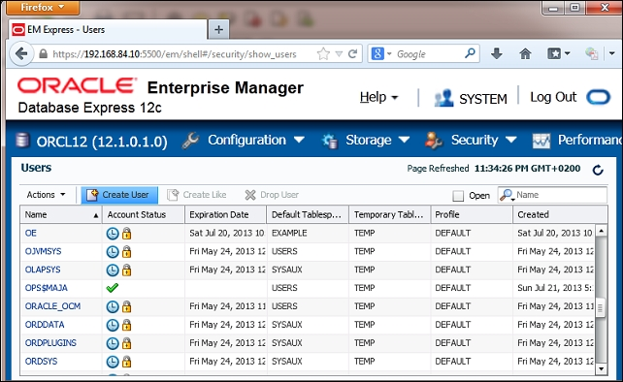
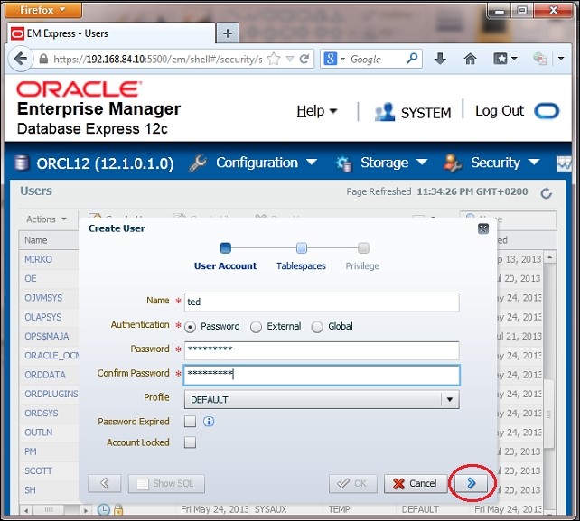
How to create a user using EM Express
3
Click on the Create User tab
Enter user details in the pop-up dialog leave the default values and click on the Next button
4

Slide 27
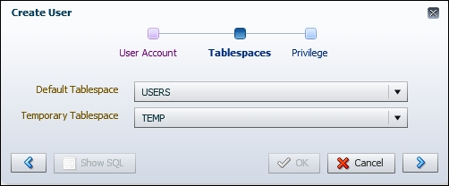
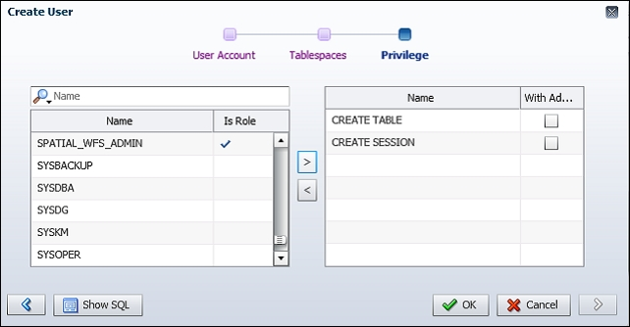
How to create a user using EM Express
Choose default tablespace and temporary tablespace from the drop-down lists. Leave the default values
5
You can grant privileges to user by selecting them in the left panel and moving them to the right pane (use > button).
6
A pop-up window confirmation should appear with the following message: SQL statement has been processed successfully. Click on the OK button to close the window.
7
Notes:
(step 6) If you want to revoke privileges, do the opposite. When you are satisfied with the list of privileges in the right panel, click on the OK button

Slide 28
Changing a user's password
You'll need an existing user who has alter user privilege (you may use OS-authenticated user who has the DBA role) and other existing users (for example, jessica and tom).

Slide 29
Changing a user's password
Use OS authentication to connect to the database.
Privilege user changes jessica's password.
tom changes his own password.

Slide 30
Changing a user's password
There is another way to change the user's password using the alter user statement as follows:
This approach is not recommended because password remains in the command-line history.
SQL> alter user jessica identified by oracle_2;

Slide 31
Creating a user with the same credentials on another database
You'll need:
An existing user who has dba role in the first database (you can use an OS-authenticated user)
An existing user in the first database (for example, jessica)
An existing (for example, password-authenticated) user, who has create user privilege, in the second database (for example, ernesto)

Slide 32
Creating a user with the same credentials on another database
Use OS authentication to connect to the database.
Find a DDL statement that has been used for user creation. This DDL statement may contain default and temporary tablespace assignments.
Use only the first part of this DDL to create a user on the second database.
SQL> select dbms_metadata.get_ddl('USER', 'JESSICA') from dual;
DBMS_METADATA.GET_DDL('USER','JESSICA')
------------------------------------------------------------------
CREATE USER "JESSICA" IDENTIFIED BY VALUES 'S:D82E6EF961F2EA7A878BCDDBC7E5C542BC148C4759D19A720A96BBF65658;H:F297A50FD538EF4AB1 19EB0278C9E72D;C50B1E9C9AA52EC2'
DEFAULT TABLESPACE "USERS" TEMPORARY TABLESPACE "TEMP"
Notes:
2. (if you haven't explicitly assigned these tablespaces during user creation, the system will assign them implicitly using default values for the database).
3. (and let the database decide about default tablespaces).

Slide 33
Creating a user with the same credentials on another database
There is another way to accomplish the task. This way requires select on the sys.user$ table:
Connect to the first database as a user who has the select privilege on the sys.user$ table:
Find the hash value of a user's password (for example, user jessica):
$ sqlplus / as sysdba
SQL> select spare4
from user$
where name='JESSICA';

Slide 34
Creating a user with the same credentials on another database
Connect to the second database as a user who has create user privilege:
Create a user with the same username (for example, jessica) using the hash value of the password:
$ sqlplus ernesto@orcl2
SQL> create user jessica identified by values
'S:2724193130FC67E7E23E3E44E33AF143F7A6C36489792B
5856133DCB331D;H:184895E50EA2FBCC2311ED76A3E5CF35;
T:BECCD5FC6F6E62BC34DF1C826AEE899EC6A6025FA0D5071659DA
7DD1ABB37763483B5C821E5A34C1184A56BE4B1C92CED79639D11101D
61B86ACBE60A30F19CC277D5753F7D3756DC1B7705C0ACE81F3';

Slide 35
Locking a user account
You'll need an existing (for example, OS-authenticated) user who has alter user privilege (you may use user who has a DBA role) and another existing user (for example, steve).

Slide 36
Locking a user account
Use OS authentication to connect to the database.
Lock the account of user steve:
However, objects in steve's schema are available, so users can access them (considering that they have necessary privileges):
SQL> alter user steve account lock;
User altered
SQL> connect steve/welcome1
ERROR: ORA-28000: the account is locked
SQL> select a, b from steve.table1;
A B
---------- ---------
1 3
2 4
4 9
Notes:
2. This means that user steve cannot connect to the database

Slide 37
Locking a user account
Unlock the account of user steve. Now user steve can successfully connect to the database:
SQL> alter user steve account unlock;
User altered.
SQL> conn steve/welcome1
Connected.

Slide 38
Expiring a user's password
You'll need an existing (for example, OS-authenticated) user who has alter user privilege (you may use user who has a DBA role) and another existing user (for example, steve).

Slide 39
Expiring a user's password
Use OS authentication to connect to the database.
Expire password for the user steve:
SQL> alter user steve password expire;
User altered.
SQL> conn steve/welcome1
ERROR: ORA-28001: the password has expired
Changing password for steve
New password:
Retype new password:
Password changed
Connected.
Notes:
2. This means that the password is no longer valid and user steve must change his password after the next login

Slide 40
Creating and using OS-authenticated users
You'll need an existing user who has a dba role, for example, johndba.
It is assumed that you are working on Linux.

Slide 41
Creating and using OS-authenticated users
In OS authentication, database delegates user authentication to the operating system.
This means that in order for OS authentication to work, user must exist as the user of the operating system, these users are created with a prefix that is defined in the os_authent_prefix parameter (default is ops$).
If an OS-authenticated user has the create session privilege, he or she can connect to the database using the following syntax:
SQL> connect /
Connected.
SQL> show user
USER is "OPS$ernesto"

Slide 42
Creating and using OS-authenticated users
Note that you cannot grant a sysdba, sysoper, sysbackup, sysdg, or syskm privilege to users that are identified externally, using a grant statement:
SQL> grant sysdba to ops$ernesto;
grant sysdba to ops$ernesto
ERROR at line 1: ORA-01997: GRANT failed: user
'OPS$ernesto' identified externally

Slide 43
Creating and using OS-authenticated users
If you want to connect as sysdba using OS authentication, you have to add OS user ernesto to OS group DBA:
You can change the os_authent_prefix parameter with custom value.
[root@db121 ~]# usermod -a -G dba ernesto
[root@db121 ~]# su - ernesto
[ernesto@db121 ~]$ sqlplus / as sysdba
SQL*Plus: Release 12.1.0.1.0 Production on Fri Sep 03 20:14:03 2013
Copyright (c) 1982, 2013, Oracle. All rights reserved.
Connected to:
Oracle Database 19c Enterprise Edition Release 12.1.0.1.0 - 64 bit
Production With the Partitioning, OLAP, Advanced Analytics and Real Application Testing options
Notes:
2. (or you can leave it blank if you want OS-authenticated database users to have the same name as OS users).

Slide 44
Creating and using proxy users
You'll need an existing (for example, OS-authenticated) user who has a DBA role and another existing user (for example, steve)

Slide 45
Creating and using proxy users
Proxy authentication is best-suited type of authentication for three-tiered environments.
The middle tier is represented as a proxy user in the database and this user can authenticate end-users in such a way that these end users can be audited by the database.
Create a user appserver (to be the proxy user). Grant this user only the create session privilege.
Notes:
It is recommended that you grant only the create session privilege to proxy users.

Slide 46
Creating and using proxy users
Authorize user steve to connect through proxy user appserver.
SQL> connect appserver[steve]
Enter password:
Connected.
SQL> show user
USER is "steve"
SQL> select sys_context('USERENV','PROXY_USER') from dual;
SYS_CONTEXT('USERENV','PROXY_USER')
-----------------------------------
APPSERVER

Slide 47
Creating and using proxy users
To see proxy users, you can query the proxy_users view:
Revoke authorization from user steve to connect through proxy user appserver.
SQL> select * from proxy_users;
PROXY CLIENT AUT FLAGS---------- ------- ---- ------------------------------------
APPSERVER steve NO PROXY MAY ACTIVATE ALL CLIENT ROLES

Slide 48
Creating and using proxy users
You can control which roles the proxy user can activate for user.
If you want the proxy user to activate only particular roles (or no roles) for a user, you can do that by adding the WITH ROLES <role1, role2, .., roleN> (or WITH NO ROLES) clause at the end of the alter user statement.
Notes:
By default, all user roles are activated.

Slide 49
Creating and using proxy users
For instance, if the user steve has many roles (including usr_role), and you want him to have only usr_role when he is connected through proxy user appserver:
SQL> alter user steve grant connect through appserver with roles usr_role;
User altered.
SQL> connect appserver[steve]
Enter password:
Connected.
SQL> select * from session_roles;
ROLE
------------
USR_ROLE
SQL> connect steve
Enter password:
Connected.
SQL> select count(*) from session_roles;
COUNT(*)
--------
25

Slide 50
Creating and using proxy users
You can request reauthentication of a user to the database.
This is done by using the authentication required clause at the end of alter user statement:
SQL> alter user steve grant connect through appserver authentication required;
User altered.
Notes:
This means that during proxy authentication, a user's password must be provided.

Slide 51
Creating and using database roles
You will need an existing (for example, OS-authenticated) user that has a dba role and another three existing users (for example, steve, tom, and jessica).
It is assumed that sample schemas are installed.

Slide 52
Creating and using database roles
Use OS authentication to connect to the database.
Grant system privileges and object privileges to the role usr_role.
Practice using database roles; grant the following:
Revoke privileges and roles by using a revoke statement. For example:
A role to another role
System and object privileges to role
Roles to users
SQL> revoke usr_role from steve;

Slide 53
Creating and using database roles
SQL> grant role1 to role2;
Grant succeeded.
SQL> grant role2 to role1;
grant role2 to role1
*
ERROR at line 1: ORA-01934: circular role grant detected
Notes:
Circular granting of roles is not allowed.

Slide 54
Creating and using database roles
Suppose that user steve grants object privilege to user jessica with a grant option and user jessica grants that privilege to user tom.
If user steve revokes that privilege from jessica, it will be automatically revoked from tom.
Notes:
You should be careful about granting privileges to the PUBLIC role because then every database user can use these privileges.
Revoking a system privilege will not cascade.

Slide 55
Creating and using database roles
SQL> grant select on hr.employees to jessica with grant option;
Grant succeeded.
SQL> connect jessica
Enter password:
Connected.
SQL> grant select on hr.employees to tom;
Grant succeeded.
SQL> connect tom/oracle_123
Connected.
SQL> select count(*) from hr.employees;
COUNT(*)
----------
107
SQL> connect steve/welcome1
Connected.
SQL> revoke select on hr.employees from jessica;
Revoke succeeded.
SQL> connect tom/oracle_123
Connected.
SQL> select count(*) from hr.employees;
select count(*) from hr.employees
*
ERROR at line 1:
ORA-00942: table or view does not exist

Slide 56
The sysbackup privilege – how, when, and why should you use it?
You'll need:
An existing database user (for example, tom) and a password file in 19c format, if you want to complete it using a password-authenticated user
An existing OS user (for example, john), who belongs to the backupdba OS group, in order to connect to the database using OS authentication
Notes:
It is recommended that you use the sysbackup administrative privilege instead of the sysdba administrative privilege to perform operations related to backup and recovery tasks.

Slide 57
The sysbackup privilege – how, when, and why should you use it?
You can use either Oracle Recovery Manager (RMAN) or SQL*Plus to perform the operations.
When you connect to the database as sysbackup, you are connected as a predefined user sysbackup. If you want to check this, run the following statement:
Otherwise, the following statement:
SQL> select user from dual;
SQL> show user

Slide 58
The sysbackup privilege – how, when, and why should you use it?
Using the sysbackup privilege, you can connect to the database even when it is not open. This privilege enables better separation of duties and the implementation of the least privilege principle.

Slide 59
The sysbackup privilege – how, when, and why should you use it?
To view the list of privileges a user can exercise when connected to the database using sysbackup privilege, you can create a user (for example, tom) and grant the user only sysbackup privileges.
The next step is to connect to the database as user tom, using the sysbackup privilege and the execute statement:
select * from session_privs;
Notes:
From a security perspective, it is recommended that you implement the least privilege principle. The least privilege principle is an important security concept that requires that users are given only those privileges they need to perform their job.

Slide 60
The sysbackup privilege – how, when, and why should you use it?
These privileges are shown in the following table:
Privileges (output from the previous statement)
sysbackup | select any transaction | select any dictionary | resumable
create any directory | alter database | audit any | create any cluster
create any table | unlimited tablespace | drop tablespace | alter tablespace
alter session | alter system

Slide 61
The sysbackup privilege – how, when, and why should you use it?
This is how you can check enabled roles:
HS_ADMIN_SELECT_ROLE is granted to SELECT_CATALOG_ROLE.
If you want to view the roles and privileges granted to sysbackup, you can query DBA_ROLE_PRIVS and DBA_SYS_PRIVS:
SQL> select * from session_roles;
ROLE
-------------------
SELECT_CATALOG_ROLE
HS_ADMIN_SELECT_ROLE
SQL> select * from dba_role_privs where grantee='SYSBACKUP';
SQL> select * from dba_sys_privs where grantee='SYSBACKUP';

Slide 62
The sysbackup privilege – how, when, and why should you use it?
Also, this new administrative privilege enables you to select, insert, delete, execute, and perform operations:
SELECT | PERFORM operations
X$ tables | STARTUP, SHUTDOWN
V$ and GV$ views | CREATE PFILE, CREATE SPFILE
APPQOSSYS.WLM_CLASSIFIER_PLAN | CREATE CONTROLFILE
SYSTEM.LOGSTDBY$PARAMETERS | FLASHBACK DATABASE
INSERT/DELETE | DROP DATABASE
SYS.APPLY$_SOURCE_SCHEMA | CREATE/DROP RESTORE POINT (including GUARANTEED restore points)
SYSTEM.LOGSTDBY$PARAMETERS
EXECUTE
SYS.DBMS_BACKUP_RESTORE | SYS.DBMS_DATAPUMP
SYS.DBMS_RCVMAN | SYS.DBMS_IR
SYS.DBMS_PIPE | SYS.SYS_ERROR
SYS.DBMS_TTS | SYS.DBMS_TDB
SYS.DBMS_PLUGTS | SYS.DBMS_PLUGTSP

Slide 63
The sysbackup privilege – how, when, and why should you use it?
You can't drop user sysbackup.
In a multitenant environment, you can restrict a user to be able to perform backups only for the PDB it can connect to.
You can accomplish that by creating a local user in the PDB and granting the sysbackup privilege to the user.

Slide 64
The sysbackup privilege – how, when, and why should you use it?
When you are connected to the database as the sysbackup, you are connected as sysbackup user to SYS schema:
SQL> connect / as sysbackup
Connected.
SQL> show user
USER is "SYSBACKUP"
SQL> select sys_context( 'userenv', 'current_schema' ) from dual;
SYS_CONTEXT('USERENV','CURRENT_SCHEMA')---------------------------------------SYS

Slide 65
The syskm privilege – how, when, and why should you use it?
You'll need:
An existing database user (for example, jessica) and a password file in the 19c format, if you want to complete it using a password-authenticated user
An existing OS user (for example, bob), who belongs to the kmdba OS group, in order to connect to the database using OS authentication
Notes:
It is recommended that you use the syskm administrative privilege instead of the sysdba administrative privilege to perform operations related to managing the transparent data encryption (TDE) keystore.

Slide 66
The syskm privilege – how, when, and why should you use it?
When you connect to the database as syskm, you are connected as a predefined user, syskm.
In most circumstances when using TDE, you don't have to have syskm administrative privilege.
You can perform operations related to managing the TDE keystore.
Notes:
1. Using the syskm privilege, you can connect to the database even when it is not open.

Slide 67
The syskm privilege – how, when, and why should you use it?
Privileges you can use when connected as syskm:
ADMINISTER KEY MANAGEMENT
CREATE SESSION
SELECT on V$ (and GV$) views:
SYS.V$ENCRYPTED_TABLESPACES
SYS.V$ENCRYPTION_WALLET
SYS.V$WALLET
SYS.V$ENCRYPTION_KEYS
SYS.V$CLIENT_SECRETS
SYS.DBA_ENCRYPTION_KEY_USAGE
SYS.DATABASE_KEY_INFO
Notes:
It is important for you to remember that: When using syskm privilege, you can't view the application data.

Slide 68
The syskm privilege – how, when, and why should you use it?
You can't drop user syskm.
When you are connected to the database as syskm, you are connected as the syskm user to SYS schema:
SQL> connect / as syskm
Connected.
SQL> show user
USER is "SYSKM"
SQL> select sys_context( 'userenv', 'current_schema' ) from dual;
SYS_CONTEXT('USERENV','CURRENT_SCHEMA')
---------------------------------------
SYS

Slide 69
The sysdg privilege – how, when, and why should you use it?
You'll need:
An existing database user (for example, steve) and a password file in the 19c format if you want to complete it using a password-authenticated user
An existing OS user (for example, kelly), who belongs to the dgdba OS group in order to connect to the database using OS authentication
Notes:
It is recommended that you use the sysdg administrative privilege instead of sysdba administrative privilege to perform operations related to data guard tasks.

Slide 70
The sysdg privilege – how, when, and why should you use it?
When you connect to the database as sysdg, you are connected as a predefined user, sysdg.
User can grant/revoke sysdg privilege to/from another existing user.
Notes:
1. Using the sysdg privilege, you can connect to the database even when it is not open.

Slide 71
The sysdg privilege – how, when, and why should you use it?
After you connect to the database using the sysdg administrative privilege, you can perform the following operations:
Operations
STARTUP, SHUTDOWN | CREATE SESSION
ALTER SESSION | SELECT ANY DICTIONARY
ALTER DATABASE | FLASHBACK DATABASE
ALTER SYSTEM | EXECUTE SYS.DBMS_DRS
CREATE/DROP RESTORE POINT (including GUARANTEED restore points) | SELECT X$ tables, V$ and GV$ views
DELETE APPQOSSYS.WLM_CLASSIFIER_PLAN | SELECT APPQOSSYS.WLM_CLASSIFIER_PLAN

Slide 72
The sysdg privilege – how, when, and why should you use it?
You can't drop user sysdg.
When you are connected to the database as sysdg, you are connected as sysdg user to the SYS schema:
SQL> connect / as sysdg
Connected.
SQL> show user
USER is "SYSDG"
SQL> select sys_context( 'userenv', 'current_schema' ) from dual;
SYS_CONTEXT('USERENV','CURRENT_SCHEMA')
------------------------------------------------------------------
SYS

Slide 73
Oracle Database 19c Security
Security Considerations in Multitenant Environment

Slide 74
Introduction
We will cover the following:
Creating a common user
Creating a local user
Creating a common role
Creating a local role
Granting privileges commonly
Granting privileges locally
The effects of plugging/unplugging operations on users, roles, and privileges

Slide 75
Introduction
The Oracle multitenant environment is a new architecture of Oracle Database, introduced in version 19c (12.1.0.1).
This chapter is focused on some of the security considerations concerning common and local users, roles, and privileges.
Notes:
It brings major changes to the way Oracle Database administrators think about the concept of databases and how they work (in a multitenant environment). One of the most significant changes is that many databases (up to 252) can share one database instance.
The prerequisite for understanding recipes in this chapter is to have at least basic knowledge of fundamental multitenant concepts, such as what is a container database (CDB), pluggable database (PDB), root container, and seed.

Slide 76


Introduction
Traditional architecture of Oracle Database.
NonCDB1
NonCDB2
Obj$
Tab$
Source$
Obj$
Tab$
Source$
User data
User data
Instance1
Instance2
SGA
SGA

Slide 77
Introduction
Data Dictionary separation
CDB
root
PDB
System Dictionary
User
Dictionary
Obj$
Tab$
Source$
Obj$
Tab$
Source$
User data

Slide 78
Introduction
A multitenant architecture
System objects
User-created objects
CDB
PDB1
Db link
root
seed
PDB2
Instance
SGA

Slide 79
Creating a common user
A common user is a user created in the root container, which has the same identity across all containers.
The main purpose of a common user is to perform "infrastructure" administrative tasks.
There are two types of common users: Oracle-supplied (for example, SYS and SYSTEM) and user-created common users.
You'll need an existing common user who has create user privilege granted commonly.
Notes:
Administrative tasks: such as starting up a CDB, plugging and unplugging PDBs, and opening PDBs

Slide 80

Creating a common user
c##maja is actually not a single user, but each container has a user named c##maja and the passwords must be the same.
cdb1
root
pdb1
pdb2
c##ernesto
c##maja
c##ernesto
c##maja
c##ernesto
c##maja
Common user

Slide 81
Rules/guidelines for creating and managing common users
There are a few rules you should be aware of:
The name of a common user must be unique across all containers. In version 12.1.0.1, it must begin with c## or C## unless you change the internal parameter common_user_prefix.
A common user can have different privileges in different containers.
The schemas for a common user may contain different objects in different containers.
Notes:
(which you shouldn't do on a production system without approval from Oracle Support) and, in version 12.1.0.2, it is best practice to use a prefix (default value c## or C##). However, you can choose it by changing the value of the common_user_prefix parameter (this naming convention doesn't apply to Oracle-supplied users in either version).

Slide 82
Creating a common user
The column oracle_maintained (in DBA_USERS) provides information as to whether a user is created and maintained by Oracle-supplied scripts:
c##ernesto@CDB1> select username, oracle_maintained from dba_users where username='SYSTEM' or username='C##ernesto';
USERNAME O
--------------- -
SYSTEM Y
C##ernesto N

Slide 83
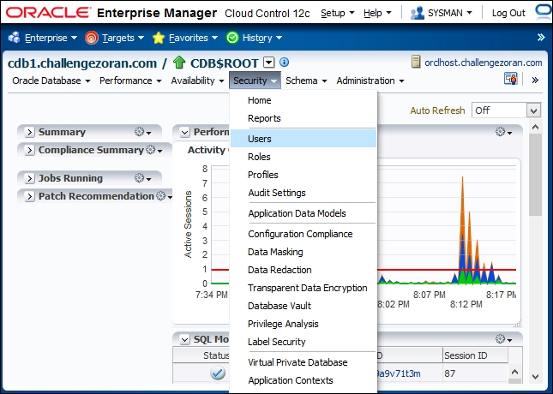
How to create a common user using OEM 19c
1
Start OEM 19c and log in using user SYSMAN or SYSTEM.
From the Databases page, select the root database in which you want to create a common user.
2
3
From the Administration menu, select Security and then Users

Slide 84
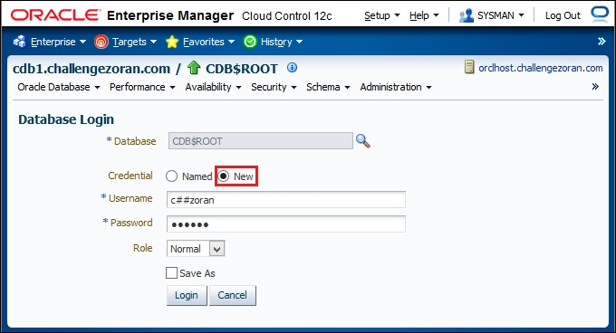
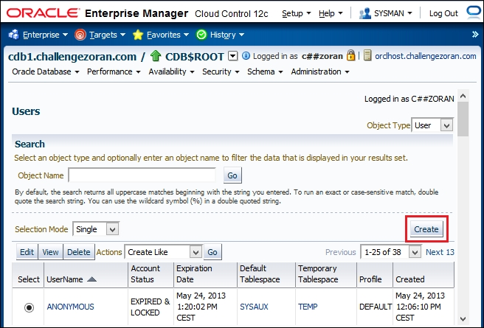
How to create a common user using OEM 19c
If prompted, log in to the root as a common user who has a create user privilege
4
5
Click on the Create button
Notes:
4. for example, c##ernesto

Slide 85
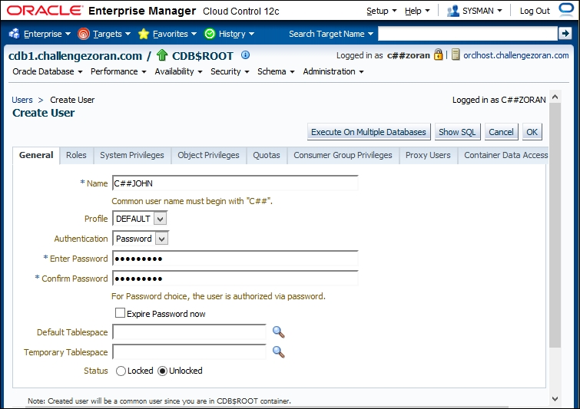
How to create a common user using OEM 19c
To create a common user, it is enough to fill out the following fields on the General tab: Name, Enter Password, and Confirm Password and then click on the OK button:
4

Slide 86
Creating a local user
A local user is a user that is created and that exists in only one PDB. A local user can't be created in the root container.
You'll need an existing user (either common or local) who has create user privilege in that pluggable database.

Slide 87

Creating a local user
cdb1
root
pdb1
pdb2
Common user
Local user

Slide 88
Rules/guidelines for creating and managing local users
There are a few rules you should be aware of:
The name of a local user must be unique within its pluggable database and it must not begin with c## or C##
A local user cannot be created in the root
A local user exists in one and only one PDB and owns a schema in that PDB

Slide 89
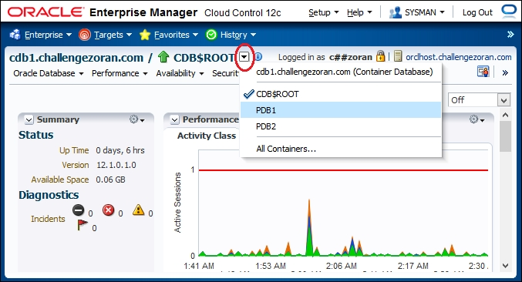
How to create a local user using OEM 19c
1
Start OEM 19c and log in using user SYSMAN or SYSTEM.
From the Databases page, select the pluggable database in which you want to create a common user.
2
3
If you want to switch container, you should click on Container Switcher and a drop-down menu will open
Notes:
Also, you can connect to PDB as a local user who has a local create user privilege.

Slide 90
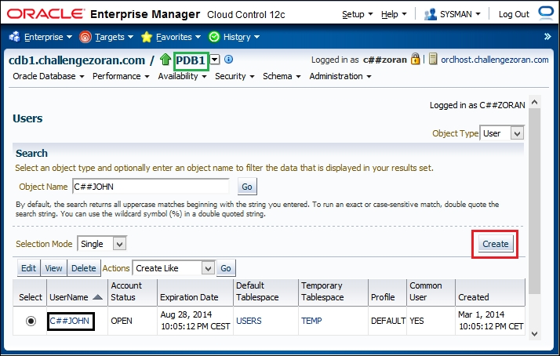
How to create a local user using OEM 19c
The common user is created in all pluggable databases that reside in the CDB and will be created in all future PDBs. By clicking on the Create button, you can create (only) a local user:
4
Notes:
it is shown that the common user you created in the previous recipe is created in the pluggable database (for example, c##john is created in pdb1; the common user is created in all pluggable databases that reside in the CDB and will be created in all future PDBs). By clicking on the Create button shown in Figure 11, you can create (only) a local user:

Slide 91
Creating a common role
Common roles are roles created in the root container and they exist in all containers.
These roles can have a different set of privileges in different containers and they can be granted to either common or local users or roles.
You'll need an existing common user who has create role privilege granted commonly.

Slide 92
Creating a common role
When you create a common role, that role exists in all containers in that database.
cdb1
root
pdb1
pdb2
Common role
Notes:
including a root container and existing and future pluggable databases

Slide 93
Creating a common role
c##ernesto@CDB1> select * from dba_roles where role='C##ROLE1';
ROLE PASSWORD AUTHENTICAT COM O
---------------- -------- ----------- --- -
C##ROLE1 NO NONE YES N
c##ernesto@CDB1> connect c##ernesto/oracle@pdb1
Connected.
c##ernesto@PDB1> select * from dba_roles where role='C##ROLE1';
ROLE PASSWORD AUTHENTICAT COM O
---------------- -------- ----------- --- -
C##ROLE1 NO NONE YES N
c##ernesto@PDB1> connect c##ernesto/oracle@pdb2
Connected.
c##ernesto@PDB2> select * from dba_roles where role='C##ROLE1';
ROLE PASSWORD AUTHENTICAT COM O
---------------- -------- ----------- --- -
C##ROLE1 NO NONE YES N

Slide 94
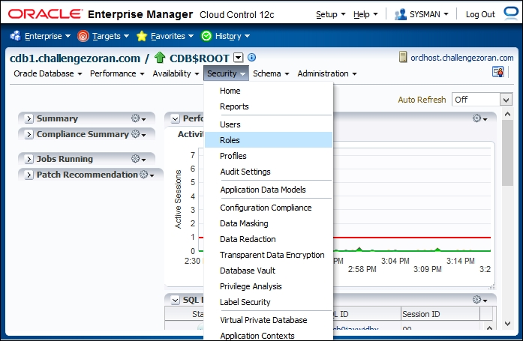
How to create a common role using OEM 19c
You should connect to the root (CDB$ROOT) as a common user who has create role privilege granted commonly.
1
From the Administration menu, select Security (drop-down menu) and then Roles

Slide 95
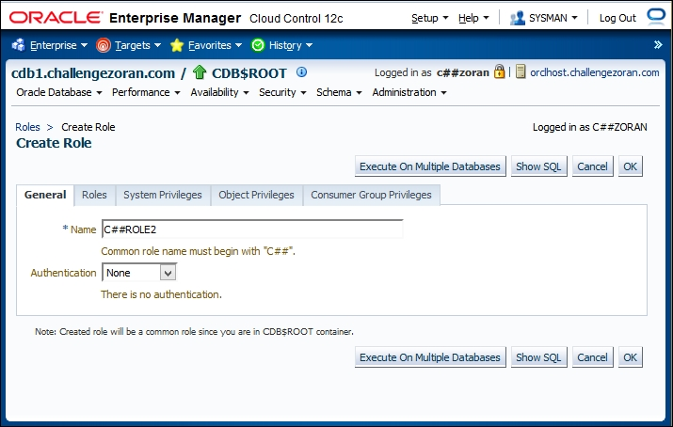
How to create a common role using OEM 19c
2
On the Roles page, click on the Create button and the Create Role page appears
On the Create Role page, you name the role on the General tab. Also, you may grant other roles and privileges to the role. Click on the OK button to create it.
3
Notes:
3. On the Create Role page, you name the role on the General tab (for example, c##role2). Also, you may grant other roles and privileges to c##role2 (using the tabs Roles, System Privileges, and Object Privileges). After choosing the options and granting privileges to the role, click on the OK button to create it.

Slide 96
Creating a local role
Local roles are roles created in PDB and they exist only in that PDB. These roles can be granted only locally to either common or local users or roles.
You'll need a pluggable database open. And an existing user (either common or local) who has create role privilege in that pluggable database.

Slide 97
Creating a local role
When you create a local role, that role exists only in the pluggable database in which it is created.
cdb1
root
pdb1
pdb2
Local role
Notes:
Local roles cannot be created in the root container. These roles are traditional roles.

Slide 98
Creating a local role
c##maja@CDB1> select * from dba_roles where role='LOCAL_ROLE1';
no rows selected
c##maja@CDB1> connect c##maja/oracle@pdb1
Connected.
c##maja@PDB1> select * from dba_roles where role='LOCAL_ROLE1';
ROLE PASSWORD AUTHENTICAT COM O
------------------- -------- ----------- --- -
LOCAL_ROLE1 NO NONE NO N
c##maja@PDB1> connect c##maja/oracle@pdb2
Connected.
c##maja@PDB2> select * from dba_roles where role='LOCAL_ROLE1';
no rows selected

Slide 99
How to create a local role using OEM 19c
You should connect to PDB as a common or local user who has create role privilege in that PDB.
All the remaining steps are done in the same way as in the How to create a common role using OEM 19c section.

Slide 100
Granting privileges and roles commonly
The common privilege is a privilege that can be exercised across all containers in a container database.
Depending only on the way it is granted, a privilege becomes common or local.
When you grant a privilege commonly (across all containers) it becomes a common privilege.
Notes:
Only common users or roles can have common privileges. Only common role can be granted commonly.

Slide 101
Granting privileges and roles commonly
You will need to connect to the root container as an existing common user who is able to grant a specific privilege or existing role to another existing common user.
You will use the following:
Common users c##maja and c##ernesto with the dba role granted commonly
Common user c##john
Common roles c##role1 and c##role2

Slide 102

Granting privileges and roles commonly
cdb1
root
pdb1
pdb2
Common user
You can grant privileges or common roles commonly only to a common user. You need to connect to the root container as a common user who is able to grant a specific privilege or role.
Common roles
Common privilege

Slide 103
Granting privileges and roles commonly
System privilege create session is granted to the common user c##john commonly by adding a container=all clause to the grant statement.
SQL> connect c##john/oracle@cdb1
Connected.
c##john@CDB1> connect c##john/oracle@pdb1
Connected.
c##john@PDB1> connect c##john/oracle@pdb2
Connected.
c##john@PDB2>
Notes:
2. This means that the user c##john can connect (create session) to the root or any pluggable database in this container database (including all pluggable databases that will be plugged in in the future).
Note that the container = all clause is NOT optional even though you are connected to the root. Unlike during the creation of common users and roles (if you omit container=all, the user or role will be created in all containers commonly), if you omit this clause during the privilege or role grant, the privilege or role will be granted locally and it can be exercised only in root container.

Slide 104
Granting privileges and roles commonly
System privilege select any table is granted to the common role c##role1 commonly.
c##ernesto@CDB1> select * from role_sys_privs where role='C##ROLE1';
ROLE PRIVILEGE ADM COM
----------------- ------------------ --- ---
C##ROLE1 SELECT ANY TABLE NO YES
c##ernesto@CDB1> connect c##ernesto/oracle@pdb1
Connected.
c##ernesto@PDB1> select * from role_sys_privs where role='C##ROLE1';
ROLE PRIVILEGE ADM COM
----------------- ------------------ --- ---
C##ROLE1 SELECT ANY TABLE NO YES
c##ernesto@PDB1> connect c##ernesto/oracle@pdb2
Connected.
c##ernesto@PDB2> select * from role_sys_privs where role='C##ROLE1';
ROLE PRIVILEGE ADM COM
----------------- ------------------ --- ---
C##ROLE1 SELECT ANY TABLE NO YES
Notes:
This means that the role c##role1 contains the select any table privilege in all containers (root and pluggable databases):

Slide 105
Granting privileges and roles commonly
The common role c##role1 is granted to another common role c##role2 commonly.
c##ernesto@CDB1> select * from role_role_privs where role='C##ROLE2';
ROLE GRANTED_ROLE ADM COM
----------------- ---------------------- ---- ---
C##ROLE2 C##ROLE1 NO YES
c##ernesto@CDB1> connect c##ernesto/oracle@pdb1
Connected.
c##ernesto@PDB1> select * from role_role_privs where role='C##ROLE2';
ROLE GRANTED_ROLE ADM COM
----------------- ---------------------- ---- ---
C##ROLE2 C##ROLE1 NO YES
c##ernesto@PDB1> connect c##ernesto/oracle@pdb2
Connected.
c##ernesto@PDB2> select * from role_role_privs where role='C##ROLE2';
ROLE GRANTED_ROLE ADM COM
----------------- ---------------------- ---- ---
C##ROLE2 C##ROLE1 NO YES
Notes:
This means that the role c##role2 has granted the role c##role1 in all containers:

Slide 106
Granting privileges and roles commonly
The common role c##role2 is granted to the common user c##john commonly.
Consequently, the user c##john can use the select any table privilege in all containers in this container database:
c##john@CDB1> select count(*) from c##ernesto.t1;
COUNT(*)
----------
4
c##john@CDB1> connect c##john/oracle@pdb1
Connected.
c##john@PDB1> select count(*) from hr.employees;
COUNT(*)
----------
107
c##john@PDB1> connect c##john/oracle@pdb2
Connected.
c##john@PDB2> select count(*) from sh.sales;
COUNT(*)
----------
918843
Notes:
5. This means that the user c##john has c##role2 in all containers.

Slide 107
Granting privileges and roles locally
A local privilege is a privilege than can be exercised only in a container in which it is granted.
Depending only on the way it is granted, a privilege becomes common or local.
When you grant privilege locally (in the current container), it becomes a local privilege.
Notes:
Both common and local users or roles can have local privileges.

Slide 108
Granting privileges and roles locally
You'll need an existing user who can grant some privileges and roles in a specific container to existing users and roles.
Local grants are valid only in the current container even though the granted user (or role) is common.
Consequently, common users and common roles can have a different set of privileges in different containers.

Slide 109
Effects of plugging/unplugging operations on users, roles, and privileges
The purpose is to show what is going to happen to users, roles, and privileges when you unplug a pluggable database from one container database and plug it into some other container database.
You will need the following:
Two container databases (cdb1 and cdb2)
One pluggable database (pdb1) in the container database cdb1
Local user steve in the pluggable database pdb1 with the local create session privilege
The common user c##john with the create session common privilege and create synonym local privilege on the pluggable database pdb1

Slide 110
Effects of plugging/unplugging operations on users, roles, and privileges
Unplug pdb1 from cdb1 and plugged it into cdb2.
The following is how you try to connect to pdb1 as a local user:
All local privileges are migrated even if they are granted to common users/roles.
However, if you try to connect to pdb1 as a previously created common user, c##john, you'll get an error, as follows:
SQL> connect steve@pdb1
SQL> connect c##john@pdb1
ERROR:
ORA-28000: the account is locked
Warning: You are no longer connected to ORACLE.
Notes:
1. After this operation, all local users and roles (in pdb1) are migrated with the pdb1 database.

Slide 111
Effects of plugging/unplugging operations on users, roles, and privileges
This happened because, after migration, common users are migrated in a pluggable database as locked accounts.
You can continue to use objects in these users' schemas, or you can create these users in a root container of a new CDB.
To do this, we first need to close pdb1.
sys@CDB2> alter pluggable database pdb1 close;
Pluggable database altered.
sys@CDB2> create user c##john identified by oracle container=all;
User created.
sys@CDB2> alter pluggable database pdb1 open;
Pluggable database altered.

Slide 112
Effects of plugging/unplugging operations on users, roles, and privileges
If we try to connect to pdb1 as the user c##john, we will get the following error:
Even though c##john had the create session common privilege in cdb1, he cannot connect to the migrated PDB.
So, we need to give the create session privilege (either common or local) to the user c##john, as follows:
SQL> conn c##john/oracle@pdb1
ERROR:
ORA-01045: user C##JOHN lacks CREATE SESSION privilege; logon denied
Warning: You are no longer connected to ORACLE.
sys@CDB2> grant create session to c##john container=all;
Grant succeeded.
Notes:
5. This is because common privileges are not migrated!

Slide 113
Effects of plugging/unplugging operations on users, roles, and privileges
We grant a create synonym local privilege to a user, c##john.
Let's try this privilege on the migrated pdb2:
This proves that local privileges are always migrated.
c##john@PDB1> create synonym emp for hr.employees;
Synonym created.

Slide 114
Oracle Database 19c Security
19c Security New Features

Slide 115
19c Security New Features
New ALTER SYSTEM Clause FLUSH PASSWORDFILE_METADATA_CACHE
Transparent Online Conversion Support for Auto-Renaming in Non-Oracle-Managed Files Mode
Support for Additional Algorithms for Offline Tablespace Encryption
Key Management of Encrypted Oracle-Managed Tablespaces in Transparent Data Encryption

Slide 116
19c Security New Features
Support for Host Name-Based Partial DN Matching for Host Certificates
New PDB_GUID Audit Record Field for SYSLOG and the Windows Event Viewer
New EVENT_TIMESTAMP_UTC Column in the UNIFIED_AUDIT_TRAIL View
Passwords Removed from Oracle Database Accounts
Signature-Based Security for LOB Locators

Slide 117
19c Security New Features
Unified Auditing Top-Level Statements
Privilege Analysis Now Available in Oracle Database Enterprise Edition
Support for Oracle Native Encryption and SSL Authentication for Different Users Concurrently
Ability to Grant or Revoke Administrative Privileges to and from Schema-Only Accounts

Slide 118
19c Security New Features
Automatic Support for Both SASL and Non-SASL Active Directory Connections
Database Vault Operations Control for Infrastructure Database Administrators
Database Vault Command Rule Support for Unified Audit Policies

Slide 119
19c Security New Features
ALTER SYSTEM Clause FLUSH PASSWORDFILE_METADATA_CACHE
Refreshes the metadata cache with the latest details of the database password file.
V$PASSWORDFILE_INFO contains the latest details of the database password file.
Useful when the database password file name or location is changed, and the metadata cache needs to be refreshed with the details of the updated database password file.

Slide 120
19c Security New Features
Transparent Online Conversion Support for Auto-Renaming in Non-Oracle-Managed Files Mode
Transparent Data Encryption online conversion in non-Oracle-managed files mode, you are no longer forced to include the FILE_NAME_CONVERT clause in the ADMINISTER KEY MANAGEMENT SQL statement. The file name retains its original name.

Slide 121
19c Security New Features
Support for Additional Algorithms for Offline Tablespace Encryption
Adds support for the AES192 and AES256 encryption algorithms, as well as for the ARIA, GOST, and 3DES encryption algorithms for offline tablespace encryption.

Slide 122
19c Security New Features
Key Management of Encrypted Oracle-Managed Tablespaces in Transparent Data Encryption
A closed Transparent Data Encryption (TDE) encryption keystore has no impact on internal operations to Oracle-managed tablespaces.
Internal processes can access a keystore when the keystore is closed, which allows the internal process to continue and successfully
Closing the TDE keystore has no effect on queries of an encrypted SYSTEM, SYSAUX, TEMP, and UNDO tablespace
User initiated operations such as decrypt on any encrypted Oracle-managed tablespace still require the TDE keystore to be in the OPEN state.

Slide 123
19c Security New Features
Support for Host Name-Based Partial DN Matching for Host Certificates
New support for partial distinguished name (DN) matching that adds the ability for the client to further verify the server certificate.
The client supports both full and partial DN matching. If the server DN matching is enabled, then partial DN matching is the default.
Partial and full DN matching for certificate verification enables more flexibility based on how the certificates were created

Slide 124
19c Security New Features
New PDB_GUID Audit Record Field for SYSLOG and the Windows Event Viewer
The audit record fields for SYSLOG and the Windows Event Viewer now include a new field, PDB_GUID
In a multitenant container database (CDB) deployment, the pluggable database that generated a unified audit trail record must be identified in the audit trail. The new field captures this information starting with this release. The data type is VARCHAR2

Slide 125
19c Security New Features
New EVENT_TIMESTAMP_UTC Column in the UNIFIED_AUDIT_TRAIL View
The new EVENT_TIMESTAMP_UTC column appears in the UNIFIED_AUDIT_TRAIL view.
The EVENT_TIMESTAMP_UTC column helps partition pruning, improving the read performance of the UNIFIED_AUDIT_TRAIL view.

Slide 126
19c Security New Features
Passwords Removed from Oracle Database Accounts
Oracle Database supplied schema-only accounts now have their passwords removed to prevent users from authenticating to these accounts.
This enhancement does not affect the sample schemas
Administrators can still assign passwords to the default schema-only accounts.
The benefit of this feature is that administrators no longer have to periodically rotate the passwords for these Oracle Database provided schemas

Slide 127
19c Security New Features
Signature-Based Security for LOB Locators
Configure signature-based security for large object (LOB) locators.
LOB signature keys are in both multitenant pluggable databases (PDBs) or in standalone, non-multitenant databases. You can enable the encryption of the LOB signature key credentials by executing the ALTER DATABASE DICTIONARY ENCRYPT CREDENTIALS SQL statement

Slide 128
19c Security New Features
Unified Auditing Top-Level Statements
Unified auditing top-level feature enables auditing top-level user (direct user) activities in the
Use this feature to audit only the events generated by top-level users, without the overhead of creating audit records for indirect SQL statements

Slide 129
19c Security New Features
Privilege Analysis Now Available in Oracle Database Enterprise Edition
Support for Oracle Native Encryption and SSL Authentication for Different Users Concurrently
You can set the new SQLNET.IGNORE_ANO_ENCRYPTION_FOR_TCPS parameter to TRUE. This setting ignores the SQLNET.ENCRYPTION_CLIENT or SQLNET.ENCRYPTION_SERVER when a TCPS client is used and either of these two parameters are set to REQUIRED.

Slide 130
19c Security New Features
Ability to Grant or Revoke Administrative Privileges to and from Schema-Only Accounts
Grant administrative privileges, such as SYSOPER and SYSBACKUP, to schema-only accounts.
Automatic Support for Both SASL and Non-SASL Active Directory Connections
Support is available for both Simple Authentication and Security Layer (SASL) and Transport Layer Security (TLS) binds for Microsoft Active Directory connections.

Slide 131
19c Security New Features
Database Vault Operations Control for Infrastructure Database Administrators
You can now use Oracle Database Vault to block common users (infrastructure database administrators, for example) from accessing local data in pluggable databases (PDBs).
Database Vault Command Rule Support for Unified Audit Policies
Oracle Database Vault command rules for unified audit policies.

Slide 132
Oracle Database 19c Security
PL/SQL Security

Slide 133
Introduction
We will cover the following:
Creating and using definer's rights procedures
Creating and using invoker's rights procedures
Using code-based access control
Restricting access to program units by using accessible by

Slide 134
Introduction
Definer is the owner of a procedure.
Invoker is a user who uses a procedure, but is not the definer of the procedure.
Definer's rights procedure is a procedure (or a program unit) that executes with the privileges of its definer.
Invoker's rights procedure is a procedure (or a program unit) that executes with the privileges of the invoker.
Notes:
Another difference between definer's and invoker's rights procedures is that invoker's rights procedures are not bound to the schema in which they are located.

Slide 135
Introduction
Code base access control is a new feature, introduced in Oracle Database 19c.
It enables you to grant database roles to PL/SQL functions, procedures, or packages.
The purpose of the accessible by clause is to limit the calling set of program units to be those in the accessible by clause and the unit itself.
Notes:
You can use it with definer's and invoker's rights procedures.

Slide 136
Creating and using definer's rights procedures
You'll learn to create and use definer's rights procedures.
You'll use a user who has a DBA role.

Slide 137
Creating and using definer's rights procedures
Definer's rights procedures are executed by using privileges that are granted to the owner of the procedure.
In our example, we have two users: procowner - a user who is the owner of the procedure and has privilege to update table ernesto.tbl and procuser - a user who just executes the procedure.
procuser creates procedure by using the AUTHID DEFINER clause, which means that this procedure will be definer's rights procedure.
This is a default behavior.
Notes:
4. (we can omit the AUTHID DEFINER clause)

Slide 138
Creating and using definer's rights procedures
procuser tries to update table ernesto.tbl directly, but it gets an error:
This is the expected behavior, considering that procuser doesn't have an update privilege on ernesto.tbl.
When procuser executes the procedure, the table is updated because the privilege of the definer is applied.
SQL> UPDATE ernesto.TBL SET B = 'value1' WHERE A = 1;
UPDATE ernesto.TBL SET B = 'value1' WHERE A = 1
*
ERROR at line 1:
ORA-01031: insufficient privileges

Slide 139
Creating and using invoker's right procedures
You'll learn to create and use invoker's rights procedures.
They can be useful when creating PL/SQL procedures in a highly privileged schema.
Also, when there is no SQL code in the PL/SQL procedure and the procedure is available to other users, invoker's rights procedure will be executed more efficiently.
There are no changes in the values of current schema and currently enabled roles during the execution.
You'll need a user who has the DBA role.
Notes:
2. (because in this case, it is more secure to grant specific privileges to the invoker).
4. (these changes are not necessary because without SQL in PL/SQL code, privilege checking is not performed).

Slide 140
Creating and using invoker's right procedures
Invoker's rights procedures are executed by using privileges that are granted to the user that executes the procedure.
The user ernesto creates an invoker's rights procedure by specifying the AUTHID CURRENT_USER clause.
When procuser1 executes that procedure, he or she succeeds because update privilege is granted to procuser1, but when procuser2 tries to execute it, he or she gets an error because procuser2 lacks the update privilege.

Slide 141
Creating and using invoker's right procedures
Let's consider this security problem.
Connect as a user who has a DBA role (for example, ernesto).
Create a new user maluser and grant him the privileges create session and create procedure.
SQL> create user maluser identified by oracle1;
SQL> grant create session, create procedure to maluser;

Slide 142
Creating and using invoker's right procedures
Connect as the user maluser and create the following "malicious" procedure with the purpose of granting him the DBA role:
SQL> connect maluser/oracle1
create or replace procedure mal_proc
authid current_user
as
begin
execute immediate 'grant dba to maluser';
end;
/

Slide 143
Creating and using invoker's right procedures
Connect as a user who has a DBA role (for example, ernesto) and execute the procedure you created in the previous step:
Connect as maluser and check whether the DBA role is granted:
SQL> connect ernesto
SQL> EXEC maluser.mal_proc;
PL/SQL procedure successfully completed.
SQL> connect maluser
SQL> select * from session_roles where role= 'DBA';

Slide 144
Creating and using invoker's right procedures
We've seen that a low-privileged user can trick the DBA user to grant him the DBA role, by tricking the DBA user (in this case, ernesto) to execute an invoker's rights procedure that was created by low-privileged user (in this case, maluser).
The user ernesto can avoid this scenario by examining code that he is executing using his own privileges and specifying users whose procedures he wants to execute using his own privileges.
The latter can be done by granting the INHERIT PRIVILEGE privilege to these users.
Notes:
Remember that this privilege is granted by default to public user, meaning that ernesto can execute procedures from all users in the database. The first thing ernesto can do is to revoke this privilege from the public user and then grant it only to users whose invoker's rights procedures he wants to execute.

Slide 145
Creating and using invoker's right procedures
Let's try this:
Connect as a user ernesto and revoke inherit privileges from public user:
SQL> connect ernesto
SQL> revoke inherit privileges on user ernesto from public;
ernesto
SQL> REVOKE INHERIT PRIVILEGES ON USER ernesto FROM PUBLIC;
public

Slide 146

Creating and using invoker's right procedures
Try to execute mal_proc:
SQL> EXEC maluser.mal_proc;
BEGIN maluser.mal_proc; END;
*
ERROR at line 1:
ORA-06598: insufficient INHERIT PRIVILEGES privilege
ORA-06512: at "MALUSER.MAL_PROC", line 1
ORA-06512: at line 1
SQL> create or replace procedure mal_proc
2 authid current_user
3 as
4 begin
5 execute immediate ‘grant dba to maluser’
6 end;
7 /
maluser
EXECUTE
ERROR at line 1:
ORA-06598: insufficient INHERIT PRIVILEGES privilege
ORA-06512: at “maluser.mal_proc”, line 1
ORA-06512: at line 1
ernesto

Slide 147
Creating and using invoker's right procedures
Grant inherit rights privileges to maluser:
SQL> grant inherit privileges on user ernesto to maluser;
SQL> create or replace procedure mal_proc
2 authid current_user
3 as
4 begin
5 execute immediate ‘grant dba to maluser’
6 end;
7 /
maluser
SQL> GRANT INHERIT PRIVILEGES ON USER ernesto TO maluser;
ernesto

Slide 148

Creating and using invoker's right procedures
Try again to execute mal_proc:
SQL> EXEC maluser.mal_proc;
PL/SQL procedure successfully completed.
SQL> create or replace procedure mal_proc
2 authid current_user
3 as
4 begin
5 execute immediate ‘grant dba to maluser’
6 end;
7 /
maluser
EXECUTE
PL/SQL procedure successfully completed.
ernesto

Slide 149
Creating and using invoker's right procedures
Users who have the inherit any privileges system privilege are exempted from this rule.
Connect as a user who has a DBA role (for example, ernesto), create two users, and grant them the following privileges:
SQL> connect ernesto
SQL> create user super_user identified by oracle1;
SQL> create user regular_user identified by oracle2;
SQL> grant create session, create procedure to super_user;
SQL> grant create session, create procedure to
regular_user;
Notes:
meaning that procedures from these users can be executed by all the users in the database.

Slide 150
Creating and using invoker's right procedures
Grant inherit any privileges only to super_user:
Connect as regular_user and create the following procedure:
SQL> grant inherit any privileges to super_user;
SQL> connect regular_user
create or replace procedure reg_proc
authid current_user
as
begin
execute immediate 'grant dba to regular_user';
end;
/

Slide 151
Creating and using invoker's right procedures
Connect as super_user and create the following procedure:
SQL> connect super_user
create or replace procedure sup_proc
authid current_user
as
begin
execute immediate 'grant dba to super_user';
end;
/

Slide 152
Creating and using invoker's right procedures
Connect as user ernesto and try to execute reg_proc from regular _user:
Try to execute sup_proc from super_user:
SQL> connect ernesto/oracle_4U
Connected.
SQL> EXEC regular_user.reg_proc;
BEGIN regular_user.reg_proc; END;
*
ERROR at line 1:
ORA-06598: insufficient INHERIT PRIVILEGES privilege
ORA-06512: at "REGULAR_USER.REG_PROC", line 1
ORA-06512: at line 1
SQL> EXEC super_user.sup_proc;
PL/SQL procedure successfully completed.
Notes:
5. (observe an error because regular_user doesn't have the inherit privileges privilege on user ernesto)
6. (this succeeds because, even though super_user doesn't have inherit privileges privilege on the user ernesto, he has inherited any privileges system privilege, which can be interpreted as inherit privileges on all users of the database):

Slide 153
Using code-based access control
In this chapter, you'll use code base access control with invoker's rights procedure.
You'll use a user who has a DBA role.

Slide 154
Using code-based access control
Code-based access control allows us to grant a role to a PL/SQL procedure, function, or package.
It works with both definer's rights and invoker's rights procedures.
The invoker's rights procedure is used to update content.
This is an invoker's rights procedure, meaning that it is executed by using privileges granted to invoker (proc_user).
However, proc_user doesn't have update privilege, but he can still execute it successfully because procedure itself contains update privilege, granted through the role proc_role.
Notes:
2. The scenario in this example shows one use of this feature.
3. Execute on this procedure is granted to the user proc_user.

Slide 155
Using code-based access control
Remember that, in some cases, privileges granted to users via roles are not active during the PL/SQL calls. Let's try this:
Connect as a user who has a DBA role (for example, ernesto), create the user plsusr, and grant him the create session and create procedure privileges:
Create the role plsrole1 and grant the create table privilege to it:
SQL> create user plsusr identified by oracle1;
SQL> grant create session, create procedure to plsusr;
SQL> create role plsrole1;
SQL> grant create table to plsrole1;

Slide 156
Using code-based access control
Grant plsrole1 to the user plsusr:
Connect as plsusr and create the procedure cr_table:
SQL> grant plsrole1 to plsusr;
SQL> connect plsusr
create or replace procedure cr_table
authid definer
as
begin
execute immediate 'create table test2(a int)';
end;
/

Slide 157
Using code-based access control
Create the table test1 to check whether the plsusr user has a create table privilege:
Execute the cr_table procedure and observe the insufficient privileges error.
SQL> create table test1(a int);
Table created.
SQL> exec cr_table;
BEGIN cr_table; END;
*
ERROR at line 1:
ORA-01031: insufficient privileges
ORA-06512: at "PLSUSR.CR_TABLE", line 5
ORA-06512: at line 1
Notes:
6, Even though the user plsusr has a create table privilege, that privilege is granted via role and roles are not active during this PL/SQL call resulting in the insufficient privileges error.

Slide 158
Using code-based access control
Connect as a user who has the DBA role and grant the create table privilege directly to the user plsusr:
Connect as the user plsusr and try to execute the procedure cr_table again.
SQL> connect ernesto
SQL> grant create table to plsusr;
SQL> connect plsusr/oracle1
SQL> exec cr_table;
PL/SQL procedure successfully completed.
Notes:
8. This time, the create table privilege is granted directly; thus, it is active during the PL/SQL call, resulting in successful completion:

Slide 159
Restricting access to program units by using accessible by
You'll learn about the effects of using the accessible by clause.
You'll use a user who has the create procedure privilege.

Slide 160
Restricting access to program units by using accessible by
An accessible by clause enables us to specify which packages can access procedures and functions of another package.
This process is called white listing.
We create the protected_pkg package and we specify that procedures and functions of this package can be accessed only by procedures and functions of public_pkg package.
We execute the public_proc procedure from the public_pkg package and, in output, we can observe that the protected_proc procedure has been successfully executed.

Slide 161
Restricting access to program units by using accessible by
However, if we try to execute protected_proc directly, we get an insufficient privileges error because the accessible by clause restricts execution of this procedure.
Even if we try to create a new package with the procedure that calls the protected_proc procedure, we get an insufficient privileges error.

Slide 162
Oracle Database 19c Security
Virtual Private Database

Slide 163
Introduction
In this chapter, we will cover the following:
Creating different policy functions
Creating Oracle Virtual Private Database row-level policies
Creating column-level policies
Creating a driving context
Creating policy groups
Setting context as a driving context
Adding a policy to a group
Exempting users from VPD policies

Slide 164
Introduction
Oracle Virtual Private Database (VPD) is a security feature, introduced in Oracle Database 8i.
Discretionary access control (DAC) grants/restricts access to data at an object level.
VPD enables you more granular control over security of your data.
Notes:
It is available only in Enterprise Edition of Oracle Database.
This means that a user can access either the entire data in a table or no data.
Using VPD, you can restrict access to data at row level or column level.
VPD doesn't replace DAC, but it is complimentary to DAC. VPD can further restrict access to users who have been given access to data by DAC.

Slide 165
Introduction
There are five types of policies based on how often a policy function is evaluated:
DBMS_RLS.DYNAMIC
DMBS_RLS.STATIC
DBMS_RLS.SHARED_STATIC
DBMS_RLS.CONTEXT_SENSITIVE
DBMS_RLS.SHARED_CONTEXT_SENSITIVE
Notes:
DBMS_RLS.DYNAMIC is default.

Slide 166
Introduction
Steps to implement the VPD policy
Create a PL/SQL package that sets application context
Create an application context
Create a policy function
Create a VPD policy
Notes:
Although it is not necessary to use application contexts when implementing VPD policies, it is a common practice. Figure 1 shows usual steps that you will need to complete to implement the VPD policy on protected objects, such as table or view:

Slide 167
Introduction
A driving context is an application context that has at least one attribute and its purpose is to determine which group of policies will be applied.
Notes:
The driving context is set by an application that is trying to access the data.

Slide 168
Introduction
Steps to implement policy groups
Determine the default policies
Create and set the driving context
Create a policy group for each application
Add policies to the appropiate policy groups
Notes:
The default VPD behavior is that all policies defined on a table or a view are enforced for all SQL statements regardless of the application that executes them. If multiple applications share a table or a view, it is highly likely that you will either need to establish more complex logic to handle security requirements (to determine in which case, which predicate should be returned) or change the default VPD behavior by creating and using policy groups. If policies are already defined, you should identify which policies should be in effect when each application accesses the table or view. Each object has a predefined default policy group (SYS_DEFAULT), and the policies defined in this group are always applied for that particular object. A driving context determines which other policy group will also be applied at that time.
Suppose that there are two applications (A and B) that access data in table HR.EMP_VPD_TEST. Their specific policies are defined in two policy groups (HR_GRP_A and HR_GRP_B), and policies that should be enforced in any case are defined in the default group (SYS_DEFAULT). When application A accesses the data, policies that belong to HR_GRP_A and SYS_DEFAULT groups are applied, and when application B accesses the data, polices that belong to HR_GRP_B and SYS_DEFAULT groups are applied (it is assumed that the driving context is properly set).

Slide 169
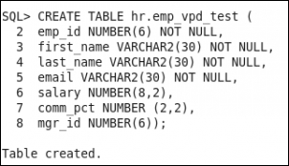
Creating different policy functions
The purpose of a policy function is to return a predicate that will be applied in WHERE clause of the statement (except for INSERT operation).
You'll create several simple policy functions, based on different business and security requirements.
You'll need to create the table hr.emp_vpd_test, insert several values into that table, and create several user.

Slide 170
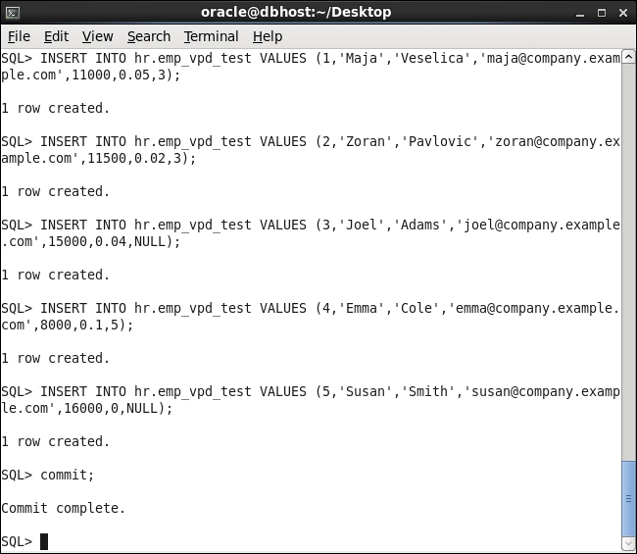
Creating different policy functions
Test data in the table hr.emp_vpd_test

Slide 171
Creating different policy functions
Create a policy function that uses the application context you created, where as other policy functions you created use built-in application contexts.
A policy function can be part of a package or is standalone.

Slide 172
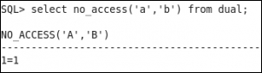
Creating different policy functions
To test whether a policy function where a user can't access data in a table and other users can access entire data in the table:
Connect to the database as the user maja and execute the following statement:
Notes:
Maja can access data

Slide 173
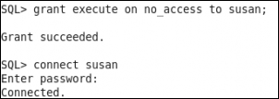
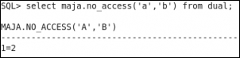
Creating different policy functions
Grant the user susan execute on no_access function and connect to the database as the user susan.
Execute the following statement:
select maja.no_access('a','b') from dual;
Notes:
2. Temporary grant the susan privilege
3. Susan can't access data

Slide 174
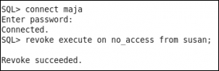
Creating different policy functions
Connect to the database as the user maja and revoke execute on no_access function from the user susan.
Notes:
Clean up environment (revoke privilege)

Slide 175
Creating Oracle Virtual Private Database row-level policies
Oracle VPD row-level policies restrict users' access per row for a protected object.
This means that two users who execute the same query against, for example, a table may, as a result, receive different number of rows.

Slide 176
Creating Oracle Virtual Private Database row-level policies
You define two VPD policies on the same table, and they are both enabled.
The first one only restricts the user susan from accessing the table, whereas the other one affects all users connected to the database.
If susan connects to the database, both policies will determine whether she can access the data and if yes, which data.
The way the policies are defined, she won't be able to view data in the table.

Slide 177
Creating column-level policies
When you create a column-level VPD policy, you define sensitive columns, and if those columns are referenced in a query, statement will be rewritten.
To create a column-level VPD policy, you also use the DBMS_RLS.ADD_POLICY procedure.

Slide 178
Creating column-level policies
Create the test_col VPD policy.
The user is granted the role (HREMP_TEST) that will allow him to view entire data.
Restrict displayed rows by TEST_POL2, so user can view only his data.

Slide 179
Creating column-level policies
Disable the TEST_POL2 policy using the DBMS_RLS.ENABLE_POLICY procedure. The syntax is:
Other user can view all rows, but cannot view salary and comm_pct, because he doesn't have the HREMP_TEST role.
DBMS_RLS.ENABLE_POLICY (
object_schema IN VARCHAR2 NULL,
object_name IN VARCHAR2,
policy_name IN VARCHAR2,
enable IN BOOLEAN TRUE)
Notes:
4. to disable the policy, you set enable parameter to false

Slide 180
Creating a driving context
Having multiple VPD policies is harder to manage, and it can lead to unexpected/unwanted results.
For example, you have two applications and want to create two policy groups.
If the first application accesses the table, the test_pol1 and test_col policies should be enforced, and if second application accesses the table, the test_pol2 policies should be applied.
Notes:
3. There will be no default policies.

Slide 181
Creating a driving context
You'll create an application context and set it.
You'll need an existing user who can create an application context.

Slide 182
Creating policy groups
You'll create two policy groups that will be applied to table hr.emp_vpd_test.
You'll need an existing user who has appropriate privileges.

Slide 183
Setting context as a driving context
You'll make an existing application context a driving context (you'll associate it with the protected object).
You'll need an existing application context and an existing user who has appropriate privileges.

Slide 184
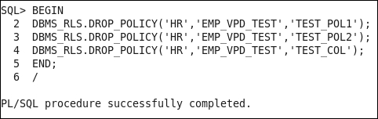
Adding policy to a group
Create VPD policies as part of a policy group.
You'll need an existing user who has appropriate privileges. Drop all VPD policies using the DBMS_RLS.DROP_POLICY procedure.
Drop policies

Slide 185
Exempting users from VPD policies
VPD policies are not enforced for users who connect as sysdba, during direct path export, and for users who have the EXEMPT ACCESS POLICY privilege.
You'll connect to the database as SYS user and grant EXEMPT ACCESS POLICY to an existing user.

Slide 186
Oracle Database 19c Security
Data Redaction

Slide 187
Introduction
We will cover the following:
Creating a redaction policy when using full redaction
Creating a redaction policy when using partial redaction
Creating a redaction policy when using random redaction
Creating a redaction policy when using regular expression redaction
Using Oracle Enterprise Manager Cloud Control 19c to manage redaction policies
Changing the function parameters for a specified column
Adding a column to the redaction policy
Enabling, disabling, and dropping a redaction policy
Exempting users from data redaction policies

Slide 188
Introduction
Oracle Data Redaction is a new security feature, introduced in Oracle Database 19c.
Oracle Data Redaction masks sensitive data just before the results of the SQL query are returned to the application that issued the query.
Data stored in the database is NOT changed in any way.
Notes:
From a licensing viewpoint, it is part of the Advanced Security Option (only available as an option for Oracle Database Enterprise Edition). However, afterwards, Oracle decided to make it available in Oracle Database 11g as well (only in version 11.2.0.4).
The main idea behind this feature is to mask (hide/redact) some (sensitive) data from end-users. Having this in mind, it is logical that you will primarily use this security solution in a production environment.

Slide 189
Introduction
Oracle Data Redaction and Oracle Data Masking are both used to mask sensitive data, but these solutions are completely different.
Oracle Data Masking enables organizations to use production data in development and test environments by changing production data with realistic data (transformation is done by using masking rules).
Notes:
—from the way they are designed (how they work) to their target implementation use cases

Slide 190
Introduction
When you implement Oracle Data Redaction, you have to decide the following:
What data should be redacted
Which redaction method is most suitable for the identified data
In which situations the redaction should take place

Slide 191
The parts of a redaction policy
WHAT | Schema, object, column
HOW | Redaction type, required parameters
WHEN | SQL expression

Slide 192
The types of redaction
None | Full | Partial | Regular Expression | Random
Redaction is NOT applied | Columns are redacted to constant values depending on column data type | User-specified positions are replaced by a user-specified characther | Pattern for matching and replacing is defined and used for redaction | Preserves data types Randomizes output
Notes:
You can define only one redaction policy on a table (or view).

Slide 193
Introduction
To view which data redaction policies are defined and whether they are enabled, you can query the redaction_policies view.
Also, it is very useful to query the redaction_columns view, which shows which columns will be masked and what type of redaction will be used.
We assume that database is up and running, and each user has at least a create session privilege.
Notes:
Note that the names of those two views do not have any prefix (such as DBA_, USER_, or ALL_).
Although Oracle Data Redaction as a concept is fantastic, you should keep in mind that there are some implementation limitations (for example, unsupported data types) and unexpected behavior (most likely bugs) observed in Oracle Database 12.1.0.2.
Recipes are tested on Oracle Database 12.1.0.2.

Slide 194
Creating a redaction policy when using full redaction
You will create a redaction policy on the income_level column, find the default values for different data types, and change the default value for the varchar2 data type.
Notes:
income_level column: on the income_level column on the CUSTOMERS table in the sample schema OE
Default values: (for full redaction)
You may consider data about customer address to be sensitive. Unfortunately, you can't create a redaction policy on the CUST_ADDRESS column (the table CUSTOMERS in the sample schema OE) because its data type is not supported (its data type is TYPE, which is not a literal value, so it can't be redacted). If you try to create a redaction policy, you will receive the following error: ORA-28073. The column CUST_ADDRESS has an unsupported data type.

Slide 195
Creating a redaction policy when using full redaction
You'll need the following:
An existing user who can view data in OE.CUSTOMERS sample table but doesn't have exempt redaction policy privilege (for example, oe)
To connect as a SYS user to the database
To restart the database

Slide 196
Creating a redaction policy when using full redaction
In order to manage redaction policies, you need to connect to a database as a user who has an execute privilege on the dbms_redact package.
Define redaction policy CUST_POL.
Creating a new redaction policy is done by using the ADD_POLICY procedure in the DBMS_REDACT package.
Notes:
3. A policy consists of several distinct sections

Slide 197
Creating a redaction policy when using full redaction
The WHAT section defines on which the column redaction policy should be applied.
The HOW section defines the redaction type.
The WHEN section defines the conditions when protected data will be masked.
Notes:
When: in situations when the expression is evaluated to TRUE, the data is masked

Slide 198
Creating a redaction policy when using full redaction
EMPLOYEES
NAME | SALARY
frank | 8800
emily | 9600
grace | 11300
SQL> SELECT * FROM EMPLOYEES;
DBMS_REDACT.ADD_POLICY
(object_schema => ‘GLDB’
object_name => ‘EMPLOYEES’
policy_name => ‘SAL_POLICY’
column_name => ‘SALARY’
function_type => DBMS_REDACT.FULL,
expression => ’7=7’);
NAME | SALARY
frank | 0
emily | 0
grace | 0
Notes:
Figure 5 - An example of the redaction policy applied on the column whose data type is a number
Figure 5 shows the example of creating a redaction policy (SAL_POLICY) using a full redaction method on a column (SALARY in table EMPLOYEES in schema GLDB) whose data type is a number. As you can see, the masked value is 0.

Slide 199
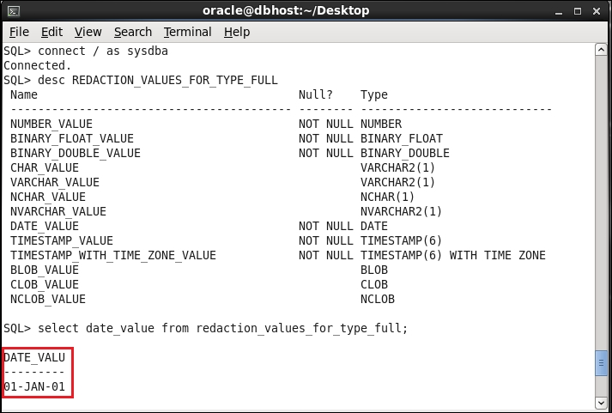
Creating a redaction policy when using full redaction
1
To find out default values for other data types, query REDACTION_VALUES_FOR_TYPE_FULL. Finding the default value for DATE data type is depicted
Notes:
Figure 6 - The default value for full redaction
At the time when you define data redaction policy, you can specify redaction for only one column. If you want to redact more than one column in a table, you can later modify the policy

Slide 200
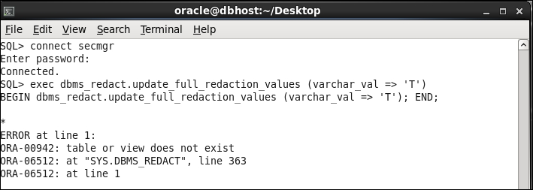
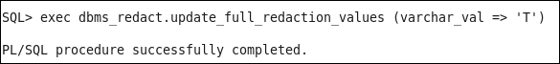
How to change the default value
1
An unsuccessful change of default value
Connect to the database as the SYS user and change the default value.
2
Notes:
You will use the update_full_redaction_values procedure to change the default value from whitespace to Tfor the varchar2 data type. Note that you can create a redaction policy, but you can't change the default value even though the user secmgr has been granted EXECUTE on the DBMS_REDACT package.
A successful change of the default value

Slide 201
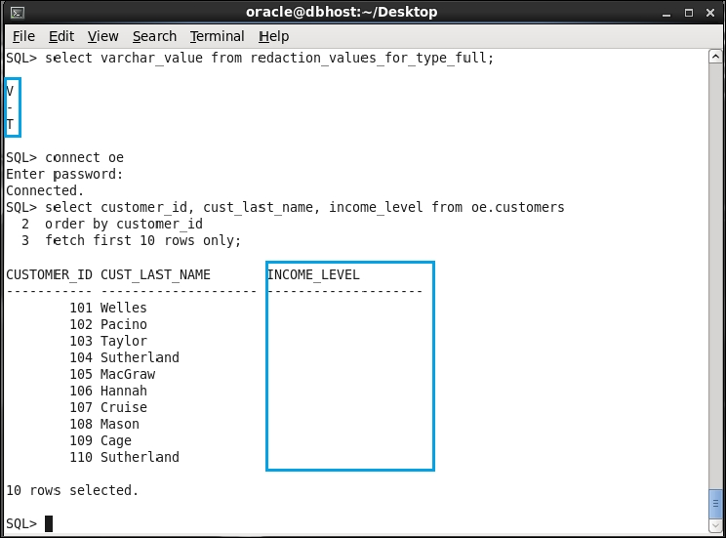
How to change the default value
3
Verify that the default value is changed and that there is no effect before you restart the database.

Slide 202
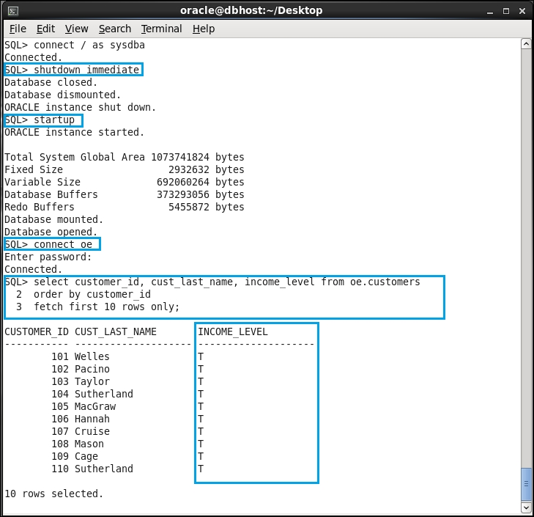
How to change the default value
4
Restart the database and verify that the modified default value is displayed.

Slide 203
Creating a redaction policy when using partial redaction
You will implement partial redaction on columns of two different types: Number and Varchar2.
Partial redaction means that only part of the data in a specified column will be masked whereas the other part of the data will be visible to the user.
Notes:
- for instance, the first 12 digits of credit card number will be redacted, whereas other 4 digits will be visible.

Slide 204
Creating a redaction policy when using partial redaction
In order to manage redaction policies and also to create some test tables, you can connect to a database as a user who has a dba role.
If you just need to manage redaction policies, you can connect with user who has the execute privilege on the dbms_redact package.

Slide 205
Creating a redaction policy when using partial redaction
Creation of redaction policy for number type column:
Create a redaction policy named a_tbl_partial.
Creating a new redaction policy is done by using the ADD_POLICY procedure in the DBMS_REDACT package.
A policy consists of several distinct sections, which column our redaction policy should be applied, redaction type, function parameters, condition when protected data will be masked.
Evaluate using the following expression: SYS_CONTEXT(''SYS_SESSION_ROLES'',''MYROLE'') = ''FALSE''
Notes:
Function parameters: in our case, it Is defined that first four digits will be redacted to 0
4. In this case, expression is true only if user doesn't have role myrole, and in this case, data in column a will be redacted (which is a case with the user usr2, whereas the user usr1, who has the role myrole, can see the unmasked data).

Slide 206
Creating a redaction policy when using partial redaction
Creation of redaction policy for the Varchar2 column type.
The difference is on function parameters and on condition, which is always TRUE.

Slide 207
Creating a redaction policy when using partial redaction
CUSTOMERS
NAME | CREDIT_CARD
tom | 3455647456589132
steve | 3734982321225691
john | 3472586894975806
SQL> SELECT * FROM CUSTOMERS;
DBMS_REDACT.ADD_POLICY
(object_schema => ‘ERNESTO’
object_name => ‘CUSTOMERS’
policy_name => ‘CCN_POLICY’
column_name => ‘CREDIT_CARD’
function_type => DBMS_REDACT.PARTIAL,
function_parameters => ‘VVVVVVVVVVVVVVVV,
VVVVVVVVVVVVVVVV, #,1,12’
expression => ’1=1’);
NAME | CREDIT_CARD
tom | ############9132
steve | ############5691
john | ############5806
Notes:
Partial redaction

Slide 208
Creating a redaction policy when using partial redaction
Even though users can't see unmasked data, they can use redacted columns in where clause:
SQL> select * from ernesto.customers;
NAME CREDIT_CARD
-------------------- ------------------------------
tom ############9132
steve ############5691
john ############5806
SQL> select * from ernesto.customers where credit_card like
'34%';
NAME CREDIT_CARD
-------------------- ------------------------------
tom ############9132
john ############5806

Slide 209
Creating a redaction policy when using random redaction
Random redaction type is usually used for the number and date-time data types because for these data types, it is hard to make a distinction between the redacted (random) and real data.
You will create redaction policy EMP_POL using random redaction type on hr.employees table, column salary, by using SQL*Plus.
You will modify the EMP_POL redaction policy.

Slide 210
Creating a redaction policy when using random redaction
To complete this, you'll need:
An existing user who can view data in the HR.EMPLOYEES sample table but doesn't have an exempt redaction policy privilege (for example, hr)
The secmgr user created in the Creating a redaction policy using full redaction recipe or another user who can create redaction policies (has execute on the dbms_redact package)

Slide 211
Creating a redaction policy when using random redaction
Create the redaction policy EMP_POL by using the procedure ADD_POLICY in the DBMS_REDACT package.
Define that random redaction type will be used to redact data.
Policy expression, specifies the blacklist (which contains only user HR).
To define a whitelist change operator = to operator <> and define left and right operand according to your needs.
Notes:
3. This means only the hr user is not allowed to view data in the column salary.
4. (for example, list only users who are allowed to view data, range of only those IP addresses from which access is allowed, and so on)
When defining security policies, it is a good practice to create whitelists.

Slide 212
Creating a redaction policy when using random redaction
When the number data type is redacted using random redaction type, the redacted value will belong to the interval [0, |n|], where |n| is the absolute value of the original data.
The only exception to this rule is when original data is an integer between −1 and 9, and in that case, the redacted value will belong to the interval [0, 9].

Slide 213
Creating a redaction policy when using regular expression redaction
A regular expression redaction type enables you to create and implement flexible redaction rules.
You define patterns that will be used in order to match and replace data, as well as some other parameters of the search.
You will create the redaction policy SHORT_POL, which will be used to mask customers' phone numbers.

Slide 214
Creating a redaction policy when using regular expression redaction
You'll need:
An existing user who can view data in the SH.CUSTOMERS sample table but doesn't have an exempt redaction policy privilege (for example, sh)
The secmgr user you created in the Creating redaction policy using full redaction recipe or another user who can create redaction policies (has execute on dbms_redact package)

Slide 215
Creating a redaction policy when using regular expression redaction
When creating redaction policies that use regular expression redaction type, you can choose between redaction shortcuts and the creation of custom regular expressions.
Notes:
redaction shortcuts : they exist for commonly redacted data, such as e-mail address, social security number, and postal code

Slide 216
Using Oracle Enterprise Manager Cloud Control 19c to manage redaction policies
You will perform several tasks with Data Redaction policies using Oracle Enterprise Manager Cloud Control 19c, including creation, modification, and deletion.
You need Enterprise Manager Cloud Control 19c and HR sample schema in the database.

Slide 217
Changing the function parameters for a specified column
There are several ways in which you can change an existing redaction policy. You will:
Change the function parameters for a specified column (the a_tbl_partial policy)
Add a column (commission_pct in the hr.employees table) to the redaction policy EMP_POL

Slide 218
Changing the function parameters for a specified column
Also, it is possible to remove column from the redaction policy, alter the policy expression, and modify the type of redaction for a specified column.
You concluded that the a_tbl_partial redaction policy doesn't satisfy the requirements for your application anymore because it redacts first four digits with 0 and leading zeros are not displayed in the application.
You decide to alter the a_tbl_partial policy.
Notes:
3. You want all digits to be displayed and to have them redacted with some value (for example, 9).

Slide 219
Changing the function parameters for a specified column
Before doing this, you should have completed the Creating a redaction policy when using partial redaction section.
You will use the secmgr user you created in the Creating a redaction policy when using full redaction section.

Slide 220
Add a column to the redaction policy
You have to modify the existing redaction policy in order to redact more than one column in the table.
In the table HR.EMPLOYEES, besides the column SALARY, you want to redact the column COMMISSION_PCT.
You will modify the redaction policy EMP_POL.
You decide that you want to use full redaction type for the column COMMISSION_PCT.
Notes:
Note that in the same redaction policy (in this case, EMP_POL) the different "protected" columns can use different redaction types (in this case, random and full redaction).

Slide 221
Add a column to the redaction policy
Before doing this, you should have completed the Creating redaction policy when using random redaction section.
You will use the secmgr user you created in the Creating redaction policy when using full redaction section.

Slide 222
Add a column to the redaction policy
Use the procedure ALTER_POLICY in the PL/SQL package DMBS_REDACT to change redaction policies.
Specify value for the ACTION parameter, which defines what kind of change will happen.

Slide 223
Enabling, disabling, and dropping redaction policy
You will perform the three basic tasks: enabling, disabling, and dropping the same redaction policy (CUST_POL).
Also, you will check which redaction policies exist in the database and whether they are enforced (enabled).
Notes:
To minimize dependence on the previous recipes in this chapter, a result shown after querying data dictionary view is equivalent to the one you would get if you completed only the Creating a redaction policy when using full redaction recipe before starting to do this recipe. The only difference you may see in the result is the number of existing redaction policies in the database.

Slide 224
Enabling, disabling, and dropping redaction policy
Before doing this, you should have completed the Creating a redaction policy when using full redaction section.

Slide 225
Exempting users from data redaction policies
You will create a user and then exempt that user from Data Redaction.
This user will be exempted from all redaction policies in the database.

Slide 226
Exempting users from data redaction policies
Before doing this, you should have completed the Creating a redaction policy when using the partial redaction section.

Slide 227
Exempting users from data redaction policies
There is a new system privilege that is used to control which users will be exempted from data redaction in Oracle Database.
This privilege is EXEMPT REDACTION POLICY.
Users who are granted this privilege will be able to see clear (unmasked) data in the whole database if they have (select) privilege to access that data.
Notes:
This means that all redaction policies in the database will not be applied to these users. The DBAand EXP_FULL_DATABASE roles both contain this privilege, so any user that has either of these roles is exempt from data redaction.

Slide 228
Exempting users from data redaction policies
Backup/restore as well as import and export operations are not subject to data redaction.
However, data redaction policies are included in export and import operations.

Slide 229
Oracle Database 19c Security
Transparent Sensitive Data Protection

Slide 230
Introduction
In this chapter, we will cover the following tasks:
Creating a sensitive type
Determining sensitive columns
Creating transparent sensitive data protection policy
Associating transparent sensitive data protection policy with sensitive type
Enabling, disabling, and dropping policy
Altering transparent sensitive data protection policy

Slide 231
Introduction
Oracle Transparent Sensitive Data Protection (TSDP) is a new security feature, introduced in Oracle Database 19c.
TSDP provides a way to create classes of sensitive data and enables more centralized control of how sensitive data is protected.
Notes:
(available only in Enterprise Edition)

Slide 232
Introduction
In database versions 12.1.0.1 and 12.1.0.2, it leverages two Oracle security mechanisms:
Oracle Virtual Private Database (VPD), described in Chapter 4 , Virtual Private Database
Oracle Data Redaction, explained in Chapter 5 , Data Redaction

Slide 233
Steps to implement TSDP
Create a sensitive data type
Associate sensitive columns with that type
Create TSDP policy
Associate the policy with the type
Enable the policy

Slide 234
Introduction
We assume that the database is up and running and each user has at least a create session privilege. I
It is assumed that the user has a DBA role and it executes privileges on the following packages:
DBMS_TSDP_MANAGE
DBMS_TSDP_PROTECT
DBMS_RLS
DBMS_REDACT
Notes:
Recipes are tested on Oracle Database 12.1.0.2 in multitenant and non-CDB environment. If you use non-CDB, connect to that database instead of pdb1 (as is done in recipes).

Slide 235
Creating a sensitive type
To create a sensitive type, you can use Oracle Enterprise Manager or a command-line interface.
You'll use the command-line interface to execute a PL/SQL procedure.
You decided that you want to protect e-mail addresses stored in your database, so first you are going to create sensitive type email_type.

Slide 236
Creating a sensitive type
You'll need an existing user who can create a sensitive type.

Slide 237
Creating a sensitive type
You create a sensitive type (for example, email_type), which you can use to consistently mask (protect).
By creating a sensitive type, you only define that in the database, there exists a class of sensitive data and you name it.
You'll define where that sensitive data resides (in which columns) and the way that data will be protected.
Notes:
), in our case, e-mail information throughout the database.
The name of a sensitive type (for example, email_type) is case-sensitive.

Slide 238
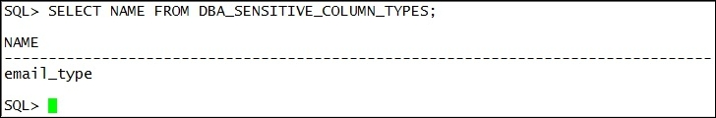
Creating a sensitive type
To view existing sensitive types, execute the following query:
select name from DBA_SENSITIVE_COLUMN_TYPES;
1
Finding information about defined sensitive types

Slide 239
Determining sensitive columns
After you decide which data is sensitive, you'll need to find all places where that data is stored.
Once you do that, you'll classify the data (associate sensitive columns with sensitive types).
You'll associate two sensitive columns (from two tables) with sensitive type you created previously.

Slide 240
Determining sensitive columns
To complete this recipe, create a user challengeernesto, create table T1, and insert several values into the table or use your own table.
Also, you'll need an existing user who has an execute privilege on dbms_tsdp_manage package (for example, c##ernesto).

Slide 241
Determining sensitive columns
Creating table T1
SQL> CREATE TABLE CHALLENGEERNESTO.T1 (NAME VARCHAR2(30), EMAIL_ADDRESS VARCHAR2(40));
Table created.
SQL> INSERT INTO CHALLENGEERNESTO.T1 VALUES (‘ERNESTO PAVLOVIC’, ‘ERNESTO.PAVLOVIC@CHALLENGEERNESTO.COM’);
1 row created.
SQL > INSERT INTO CHALLENGEERNESTO.T1 VALUES (‘MAJA VESELICA’, ‘MAJA.VESELICA@CHALLENGEERNESTO.COM’);
1 row created.
SQL> COMMIT;
Commit complete.
SQL> SELECT * FROM CHALLENGEERNESTO.T1;
NAME EMAIL_ADDRESS
_ _ _ _ _ _ _ _ _ _ _ _ _ _ _ _ _ _ _ _ _ _ _ _ _ _ _ _ _ _ _ _ _ _ _ _ _ _ _ _ _ _ _ _ _ _ _ _
ERNESTO PAVLOVIC ERNESTO.PAVLOVIC@CHALLENGEERNESTO.COM
MAJA VESELICA MAJA.VESELICA@CHALLENGEERNESTO.COM
SQL
Notes:
To complete this recipe, create a user challengeernesto, create table T1, and insert several values into the table (see Figure 1) or use your own table. Also, you'll need an existing user who has an execute privilege on dbms_tsdp_manage package (for example, c##ernesto).

Slide 242
Determining sensitive columns
Define where sensitive data resides and associated it with previously created sensitive data type.
You can associate a column with only one sensitive type. If you try to associate it with another type, you'll receive ORA-45607.

Slide 243
Creating transparent sensitive data protection policy
This step defines the way you want to protect sensitive data.
You can use Data Redaction or VPD settings for your TSDP policy.
In this recipe, you'll use regular expression redaction to protect previously defined sensitive data.

Slide 244
Creating transparent sensitive data protection policy
To complete this, you'll need an existing user who has the execute privilege on the dbms_tsdp_protect package.

Slide 245
Creating transparent sensitive data protection policy
Define variables redact_features_options and policy_conditions.
Data redaction settings, for TSPD policy, are defined by using redact_features_options variable that holds parameter-value pairs that correspond with the parameters in DBMS_REDACT.ADD_POLICY procedure.
Specify that data type of protected columns should be VARCHAR2 in order for redaction settings to be applied on the column.

Slide 246
Associating transparent sensitive data protection policy with sensitive type
You'll associate TSDP policy and sensitive type you created previously.
You'll need an existing user who has the execute privilege on the dbms_tsdp_protect package.

Slide 247
Associating transparent sensitive data protection policy with sensitive type
To verify that you successfully associated the TSDP policy and the sensitive type, execute the following query:
SQL> SELECT POLICY_NAME, SENSITIVE_TYPE FROM DBA_TSDP_POLICY_TYPE;

Slide 248
Enabling, disabling, and dropping policy
You'll learn to enable, disable, and drop transparent sensitive data protection policies.
You'll need two existing users-one to manage TSDP policies and the other to view sensitive data.

Slide 249
Enabling, disabling, and dropping policy
Correct result-column email_address in schema challengeernesto is masked like specified in the policy and full redaction is applied on all values in column email in schema HR where data isn't matched to the specified pattern.
Before you drop the policy, you don't have to disable it.

Slide 250
Enabling, disabling, and dropping policy
Another way to enable/disable protection is to use procedures enable_protection_column (disable_protection_column):
SQL> begin
DBMS_TSDP_PROTECT.ENABLE_PROTECTION_COLUMN(
schema_name =>'CHALLENGEernesto',
table_name =>'T1',
column_name =>'EMAIL_ADDRESS',
policy => 'redact_regexp_email');
end;
/
SQL> begin
DBMS_TSDP_PROTECT.ENABLE_PROTECTION_COLUMN(
schema_name =>'HR',
table_name =>'EMPLOYEES',
column_name =>'EMAIL',
policy => 'redact_regexp_email');
end;
/
SQL> begin
DBMS_TSDP_PROTECT.DISABLE_PROTECTION_COLUMN(
schema_name =>'CHALLENGEernesto',
table_name =>'T1',
column_name =>'EMAIL_ADDRESS',
policy => 'redact_regexp_email');
end;
/
SQL> begin
DBMS_TSDP_PROTECT.DISABLE_PROTECTION_COLUMN(
schema_name =>'HR',
table_name =>'EMPLOYEES',
column_name =>'EMAIL',
policy => 'redact_regexp_email');
end;
/

Slide 251
Altering transparent sensitive data protection policy
You'll alter policy you created in recipe Creating transparent sensitive data protection policy and enable it.

Slide 252
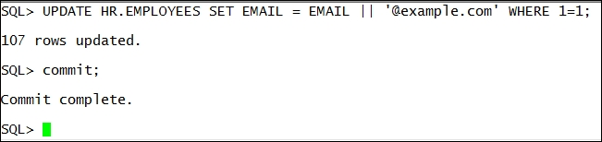
Altering transparent sensitive data protection policy
You'll need two existing users. Also, update the table hr.employees, as shown:
Notes:
Set new e-mail addresses in the hr.employees table

Slide 253
Altering transparent sensitive data protection policy
After you alter the policy, you have to manually enable it (it isn't automatically enabled).

Slide 254
Oracle Database 19c Security
Privilege Analysis

Slide 255
Introduction
In this chapter, we will cover the following tasks:
Creating a database analysis policy
Creating a role analysis policy
Creating a context analysis policy
Creating a combined analysis policy
Starting and stopping privilege analysis
Reporting on used system privileges
Reporting on used object privileges
Reporting on unused system privileges
Reporting on unused object privileges
How to revoke unused privileges
Dropping the analysis

Slide 256
Introduction
Privilege analysis is a new security feature, introduced in Oracle Database 19c.
Privilege analysis is very useful to implement and maintain the least privilege principle by identifying both privileges that users are actually using (used privileges) and those that are only granted to them (unused privileges).
Notes:
It is only available in Oracle Database Enterprise Edition, and from licensing viewpoint, it is part of Oracle Database Vault option.

Slide 257
The steps to analyze the used and unused privileges
Create capture
Start capture
Stop capture
Generate report

Slide 258
Introduction
In this chapter, it is assumed that all users have a create session privilege, and in the following table, other privileges and roles granted to the users and roles are listed:
USER/ROLE | HR.EMPLOYEES | OE.ORDERS | ROLES/SYS.PRIVS.
BARBARA |  |  | P1_ROLE
NICK |  |  | DBA
ALAN | SELECT, INSERT, UPDATE, DELETE
STEVE |  |  | P2_ROLE
P1_ROLE | SELECT
P2_ROLE |  | SELECT, INSERT, UPDATE, DELETE | SELECT ANY TABLE, CREATE TABLE

Slide 259
Introduction
Depending on your needs, you can create and use four different types of privilege analysis policies that differ in the scope of the analysis. This scope can be:
An entire database
Role-based
Context-based
Role- and context-based

Slide 260
Creating database analysis policy
You'll learn to create database privilege analysis policy.
It analyzes privileges in the whole database (except privileges used by SYS user).
You can use SQL*Plus and Enterprise Manager Cloud Control 12.1.0.3+ (in our case, EM19cR4) to create privilege analysis policies.

Slide 261
Creating database analysis policy
You'll need an existing user who can create a privilege analysis policy (has CAPTURE_ADMIN role and SELECT ANY DICTIONARY privilege), for example, SYSTEM user.

Slide 262
Creating database analysis policy
Create database-wide policy that will capture privileges, which are used by users (except the SYS user).
However, to start gathering data about privilege usage, you have to enable the policy.
Notes:
1. (and which are granted, but are unused)

Slide 263
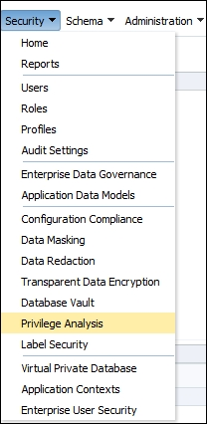
Creating database analysis policy
1
Login to EM as a user who has appropriate privileges and select Privilege Analysis from Security drop-down menu:
Notes:
The choose privilege analysis

Slide 264
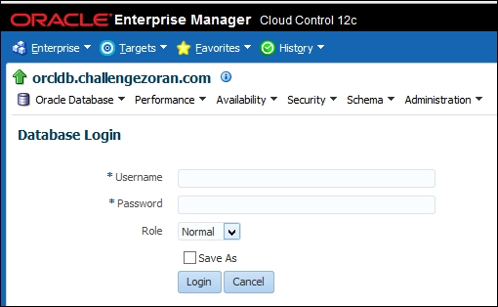
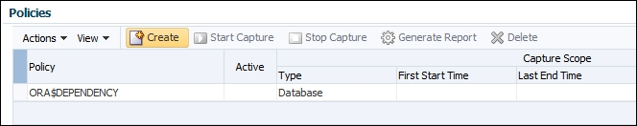
Creating database analysis policy
Log in to the database as SYSTEM user or a user who has appropriate privileges (CAPTURE_ADMIN role and SELECT ANY DICTIONARY privilege).
2
3
Click on the Create button in the Policy section
Notes:
2. The login screen
3. Start the process of creating a privilege analysis policy

Slide 265
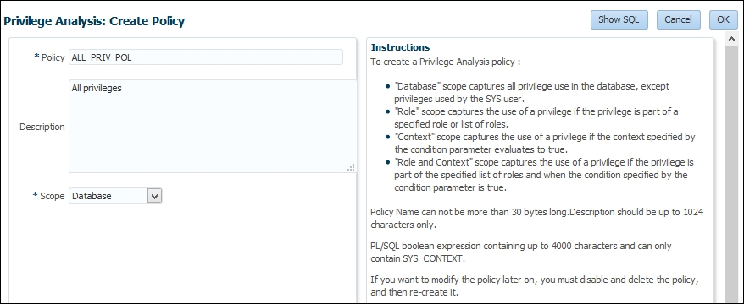
Creating database analysis policy
To create a database policy, choose that scope is Database, name the policy, and optionally write a description. Click on the OK button.
4
Notes:
4. The create policy

Slide 266
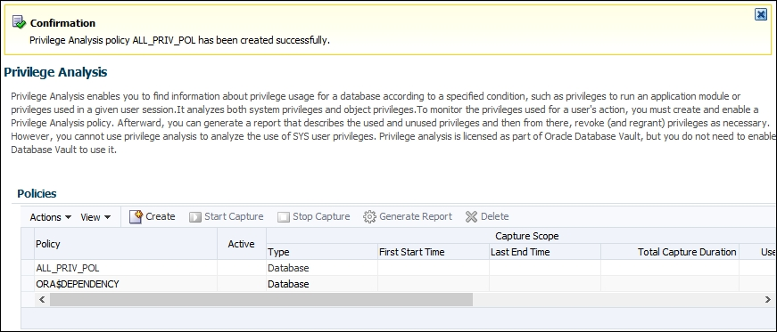
Creating database analysis policy
You should receive a confirmation message and see your newly created policy listed in the table
5
Notes:
A successful message

Slide 267
Creating role analysis policy
You'll create a role analysis policy using SQL*Plus and Enterprise Manager Cloud Control 19c (EM).
The usage of directly and indirectly granted privileges to the roles listed in the policy, will be captured if the roles are active for the session.

Slide 268
Creating role analysis policy
You'll need an existing user who can create a privilege analysis policy (has a CAPTURE_ADMIN role and a SELECT ANY DICTIONARY privilege), for example, SYSTEM user.

Slide 269
Creating role analysis policy
1
Login to EM as a user who has appropriate privileges and select Privilege Analysis from Security drop-down menu:
Log in to the database as SYSTEM user or a user who has appropriate privileges (CAPTURE_ADMIN role and SELECT ANY DICTIONARY privilege).
2
3
Click on the Create button in the Policy section
Notes:
See steps in previous section

Slide 270
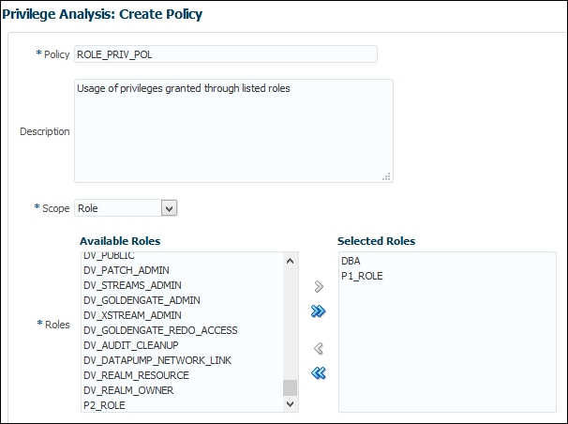
Creating role analysis policy
Name the policy, select roles, optionally write a description, and click on OK button
4
Notes:
Creating a role policy

Slide 271
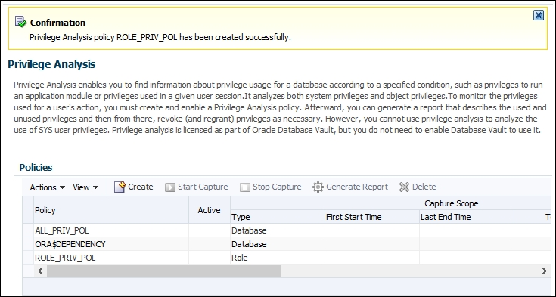
Creating role analysis policy
You should receive a confirmation message and see your newly created policy listed in the table
5
Notes:
The successful creation of the policy

Slide 272
Creating context analysis policy
You'll create a context analysis policy.
After the policy is enabled, it will capture privileges when the condition specified in the policy evaluates to true.
You'll need an existing user who can create a privilege analysis policy (has the CAPTURE_ADMIN role and the SELECT ANY DICTIONARY privilege), for example, the SYSTEM user.

Slide 273
Creating context analysis policy
1
Login to EM as a user who has appropriate privileges and select Privilege Analysis from Security drop-down menu:
Log in to the database as SYSTEM user or a user who has appropriate privileges (CAPTURE_ADMIN role and SELECT ANY DICTIONARY privilege).
2
3
Click on the Create button in the Policy section

Slide 274
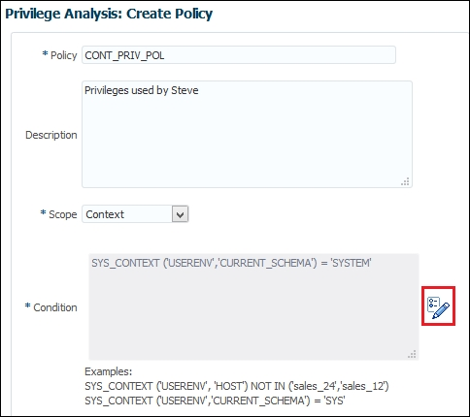
Creating context analysis policy
4
Name the policy and optionally write a description
Notes:
The create context policy

Slide 275
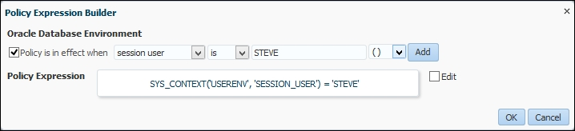
Creating context analysis policy
Click on the Build Context Expression button. You can enter expression manually or use the built-in help. Click on the OK button.
5
Notes:
Build Context Expression button: a pencil icon
enter expression manually: select Edit checkbox
built-in help: select the checkbox Policy is in effect when select appropriate options from drop-down menus, click on the Add button

Slide 276
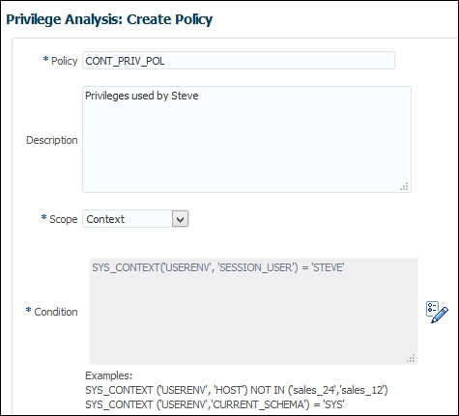
Creating context analysis policy
6
Make sure that you chose options you wanted and then click on the OK button
Notes:
Checking the filled-out context policy

Slide 277
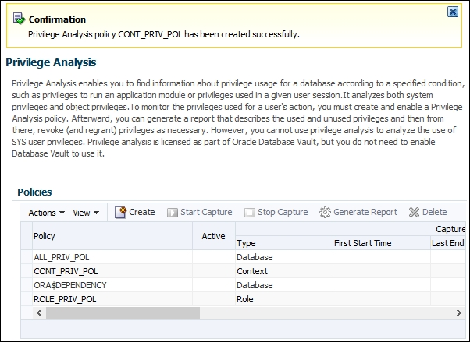
Creating context analysis policy
You should receive a confirmation message and see your newly created policy listed in the table.
7
Notes:
The context policy has been successfully created

Slide 278
Creating combined analysis policy
You'll create a combined analysis policy.
This type of policy defines that the usage of directly and indirectly granted privilege to specified roles will be gathered if roles are enabled in the session and the context condition is satisfied.
The context condition can consist of one or more conditions (you can use the AND or OR Boolean operators).

Slide 279
Creating combined analysis policy
You'll need an existing user who can create a privilege analysis policy (has the CAPTURE_ADMIN role and the SELECT ANY DICTIONARY privilege), for example, the SYSTEM user.

Slide 280
Creating combined analysis policy
1
Login to EM as a user who has appropriate privileges and select Privilege Analysis from Security drop-down menu:
Log in to the database as SYSTEM user or a user who has appropriate privileges (CAPTURE_ADMIN role and SELECT ANY DICTIONARY privilege).
2
3
Click on the Create button in the Policy section

Slide 281
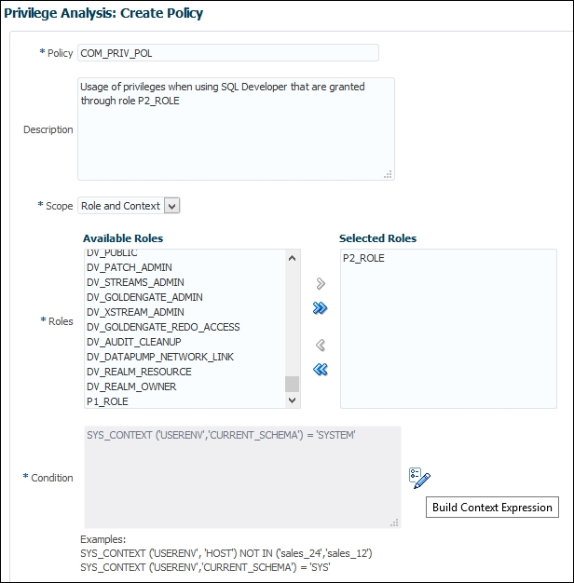
Creating combined analysis policy
Name the policy, select roles, and optionally write a description. Click on Build Context Expression
4
Notes:
Creating the combined policy

Slide 282
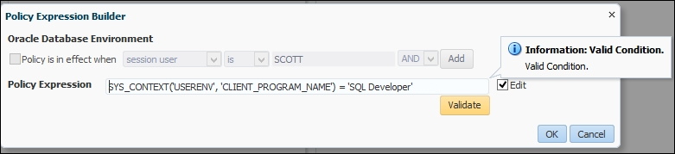
Creating combined analysis policy
Manually write the policy expression. Click on the Validate button and then on the OK button
5
Notes:
Manually write expression in the Policy Expression Builder

Slide 283
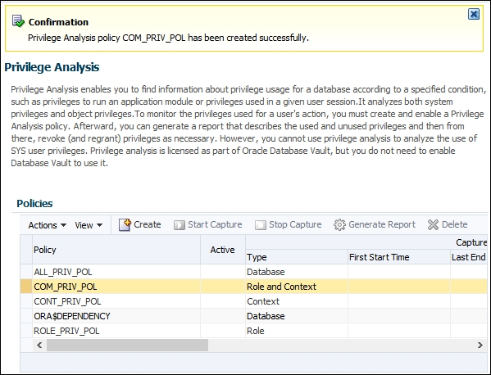
Creating combined analysis policy
6
You should receive a confirmation message and see your newly created policy listed in the table.
Notes:
The successful message

Slide 284
Starting and stopping privilege analysis
To start capturing privileges, you'll enable privilege analysis policies you created previously.
You'll need an existing user who can manage privilege analysis policies (has the CAPTURE_ADMIN role and the SELECT ANY DICTIONARY privilege), for example, the SYSTEM user.

Slide 285
Starting and stopping privilege analysis
Start capturing privileges according to the policy ALL_PRIV_POL.
Then, execute several statements as the user ALAN.
The point of those statements is to generate records.

Slide 286
Starting and stopping privilege analysis
Stop capturing the privilege usage.
Populate DBA_USED_XXX and DBA_UNUSED_XXX data dictionary views.
Notes:
You can see how to use the results of capture later in this chapter.

Slide 287
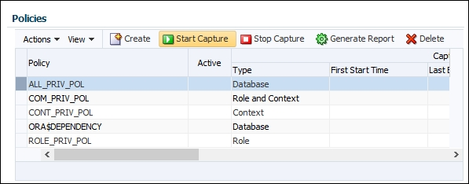
Starting and stopping privilege analysis
1
Login to EM as a user who has appropriate privileges and select Privilege Analysis from Security drop-down menu:
Log in to the database as SYSTEM user or a user who has appropriate privileges (CAPTURE_ADMIN role and SELECT ANY DICTIONARY privilege).
2
3
Select the database policy and click on the Start Capture button
Notes:
3. Enabling a policy

Slide 288
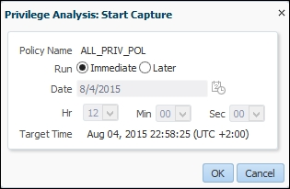
Starting and stopping privilege analysis
4
You can either start capture immediately or schedule it. Leave the defaults and click on the OK button
Notes:
Start capture immediately

Slide 289
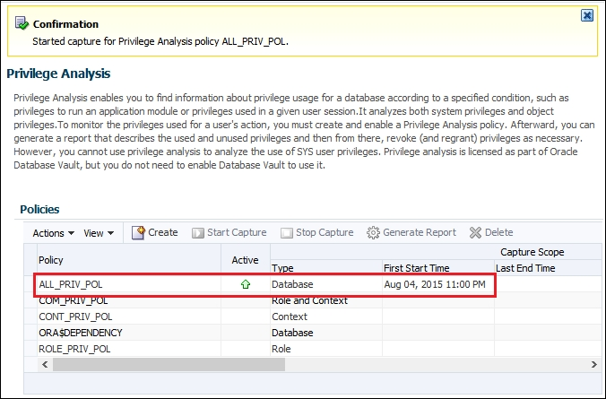
Starting and stopping privilege analysis
You should receive a confirmation message and see that your policy is active
5
Notes:
An active capture

Slide 290

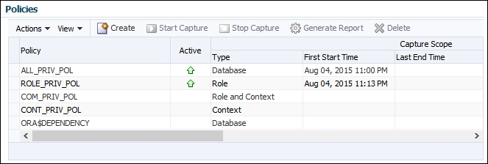
Starting and stopping privilege analysis
6
Select the role policy and click on Start Capture
You should see under the Policies section that both policies are active
7
Notes:
6. Enabling role policy
7. Active policies
Keep in mind that only one policy whose type is Database and one policy whose type is not Database could be active at any given time.

Slide 291
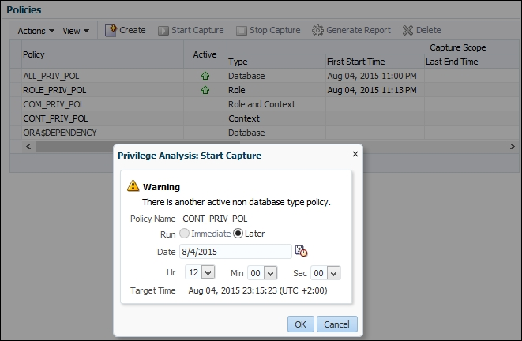
Starting and stopping privilege analysis
Verify that you can't enable another non-database policy while role policy is active. Select CONT_PRIV_POL and click on the Start Capture button. You'll receive warning message, and you'll only be able to schedule job to run at later point in time
8
Notes:
Warning message

Slide 292
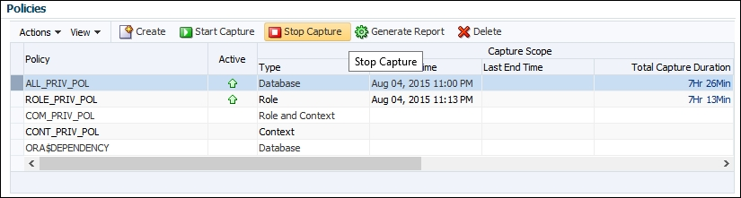
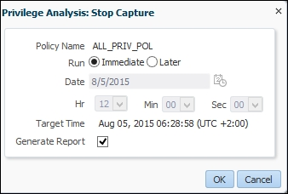
Starting and stopping privilege analysis
To disable capture, select an active policy (for example, ALL_PRIV_POL) and click on the button Stop Capture
9
10
Choose to immediately stop capture and tick generate report checkbox. Click on the OK button
Notes:
9. Stop capture
10. Stop capture and generate report

Slide 293

Starting and stopping privilege analysis
You should receive confirmation message that capture has been stopped and that job has been submitted
11
Notes:
Confirmation

Slide 294

Starting and stopping privilege analysis
12
Refresh page
Notes:
Refresh page (it may take up to several minutes to complete). You should receive result similar to the one shown
12. The generated report
Test all policies you have created in the previous recipes.

Slide 295
Reporting on used system privileges
You'll view collected data about the usage of system privileges during a capture interval.
You'll need an existing user who can create a privilege analysis policy (has the CAPTURE_ADMIN role and the SELECT ANY DICTIONARY privilege), for example, the SYSTEM user.

Slide 296

Reporting on used system privileges
In EM 19c, after you have generated the report, select the policy and from Actions drop-down menu, select Reports. The Usage Summary report will open
1
Notes:
1. Usage Summary

Slide 297

Reporting on used system privileges
Click on the tab Used and choose All for Match radio button, Policy: ALL_PRIV_POL, User Name: ALAN, and click on the Search button.
2
Notes:
Report the used privileges recorded for the user Alan based on the database policy

Slide 298

Reporting on used system privileges
If you haven't generated report for the role policy, do it now and return to this tab (the Used tab). Find all records generated by ROLE_PRIV_POL for user Nick (who has a DBA role).
3
Notes:
The used privileges recorded for the user Nick based on role policy

Slide 299
Reporting on used object privileges
You'll view collected data about the usage of object privileges during the capture interval.
You'll need an existing user who can create a privilege analysis policy (has the CAPTURE_ADMIN role and the SELECT ANY DICTIONARY privilege), for example, the SYSTEM user.

Slide 300

Reporting on used object privileges
In EM 19c, after you have generated the report, select the policy, and from Actions drop-down menu, select Reports. The Usage Summary report will open. Click on the Used tab and verify that the user Alan has used the SELECT and DELETE privileges while ALL_PRIV_POL has been active
1
Notes:
Reports

Slide 301
Reporting on unused system privileges
You'll view the collected data about the unused system privileges during the capture interval.
You'll need an existing user who can create a privilege analysis policy (has the CAPTURE_ADMIN role and the SELECT ANY DICTIONARY privilege), for example, the SYSTEM user.

Slide 302
Reporting on unused system privileges
To view report about the unused system privileges in EM19c, see instructions to view the used system privileges and under Privilege Analysis: Reports, choose the Unused tab instead of the Used tab.

Slide 303
Reporting on unused object privileges
You'll view collected data about the unused object privileges during the capture interval.
You'll need an existing user who can create a privilege analysis policy (has the CAPTURE_ADMIN role and the SELECT ANY DICTIONARY privilege), for example, the SYSTEM user.

Slide 304

Reporting on unused object privileges
In EM 19c, after you have generated the report, select the policy, and from Actions drop-down menu, select Reports. The Usage Summary report will open. Click on the Unused tab and verify that the user Alan hasn't used the INSERT and UPDATE privileges while ALL_PRIV_POL has been active.
1
Notes:
The Unused object privileges report

Slide 305
How to revoke unused privileges
You can manually revoke unused privileges one by one from users, write your own scripts to complete that task, or use Enterprise Manager Cloud Control 19c.
You'll use EM19c to efficiently revoke unused privileges based on reports you generated in the previous recipes.

Slide 306
How to revoke unused privileges
In EM 19c, there is another excellent option to create a new role based on privilege analysis results.
This way, you won't change an existing role (and affect other users and roles who have that role), but create a new one and afterwards revoke the old role and grant a newly created one.

Slide 307

How to revoke unused privileges
You can select it from the Actions menu (Create Role). The configuration part of a process for creating a new role is shown
1
Notes:
Create a new role based on policy

Slide 308
Dropping the analysis
In this recipe, you'll drop an existing privilege analysis policy.
It has to be disabled before dropping; otherwise, you'll receive an error.
You'll need an existing user who can manage privilege analysis policies (has the CAPTURE_ADMIN role and the SELECT ANY DICTIONARY privilege), for example, the SYSTEM user and an existing privilege analysis policy.

Slide 309
Dropping the analysis
In EM 19c under the Policies section, select policy you want to drop and click on the Delete button.

Slide 310
Oracle Database 19c Security
Transparent Data Encryption

Slide 311
Transparent Data Encryption
We will cover the following tasks:
Configuring a keystore location in sqlnet.ora
Creating and opening the keystore
Setting a master encryption key in a software keystore
Column encryption - adding a new encrypted column to a table
Column encryption - creating a new table that has encrypted column(s)
Using salt and MAC
Column encryption - encrypting the existing column
Autologin keystore
Encrypting tablespace
Rekeying
Backup and recovery

Slide 312
Introduction
Encryption is a very important security mechanism used to enforce confidentiality of data.
There are two types of encryption that can be used in the Oracle Database.
The first type is application-based encryption, which is implemented using the DBMS_CRYPTO PL/SQL package.
Notes:
3. (this type is not covered here)

Slide 313
Introduction
The second type is Transparent Data Encryption (TDE).
TDE is a part of Advanced Security option of Oracle Database Enterprise Edition.
It can be used to encrypt data in rest (table columns and tablespaces inside the database) and in transit (network, Recovery Manager (RMAN) backups, and Data Pump Exports).

Slide 314
Introduction
The word transparent in Transparent Data Encryption means that application is not aware that data is encrypted in any way.
The application will never see the encrypted data-if user is not authorized to see the data, error will be shown.
The only way that a user will see encrypted data is if he or she tries to avoid Oracle Database Access Controls, by reading data files directly.
Notes:
Error: (for example, insufficient privileges, table, or view does not exist)

Slide 315
Introduction
TDE should never be used as a mechanism of access control.
There are two types of TDE: column and tablespace.
Notes:
For this purpose, there is a large portfolio of access control mechanisms in Oracle Database (standard Discretionary Access Control, Mandatory Access Control-Oracle Label Security, Virtual Private Database, Database Vault, and so on).

Slide 316
Introduction
In column encryption, only user-selected columns (in user-selected tables) are encrypted.
This encryption type is more suitable for systems with small number of columns that need to be encrypted.
Encrypting large number of columns can lead to significant performance degradation.
Notes:
This type even encrypts data in memory, which prevents cold boot attacks.

Slide 317
Introduction
There are several encryption algorithms that can be chosen from: AES128, AES192, AES256, and 3DES168.
The default one is AES192.
Because these are block cyphers, each row that is going to be encrypted need to be padded to a multiple of 16 bytes.
By default, salt and MAC are used.
Notes:
3. (for example, if the size of value in row is 11 bytes, additional 5 bytes of storage is needed to encrypt this row)

Slide 318
Introduction
There are several restrictions of column encryption:
Foreign key constraints are not supported because each table has a different table key
B-Tree indexes are not supported when using salt
Bitmap indexes are not supported

Slide 319
Introduction
Transportable tablespaces are not supported
Synchronous Change Data Capture (CDC) is not supported
External Large Objects (LOBs) are not supported
SYS schema objects cannot be encrypted

Slide 320
Introduction
Tablespace encryption is the second type of TDE, which has better performance and has fewer restrictions.
This type of TDE is usually more suitable for systems that need to encrypt large portion of data in the database.
Using this type, all data that resides inside encrypted tablespace is encrypted (no restrictions on data types).

Slide 321
Introduction
Encryption/decryption is performed on the I/O level, so performance overhead can be expected to be seen on that level.
Tablespace encryption doesn't require additional storage.

Slide 322
Introduction
Unlike column encryption, tablespace encryption supports the following:
Foreign keys
Bitmap indexes
Transportable tablespaces (as long as platforms are of the same endian and the same keystore exists on both locations)
All data types

Slide 323
Introduction
However, there are still some limitations:
BFILE cannot be encrypted
External tables cannot be encrypted
UNDO tablespace cannot be encrypted
Notes:
These things are not supported in tablespace encryption

Slide 324
Introduction
TEMP tablespace cannot be encrypted
SYSTEM tablespace cannot be encrypted
Key for tablespace cannot be rekeyed
Notes:
3. (workaround is to create another encrypted tablespace and move all data to this newly created tablespace)

Slide 325
Introduction
TDE uses two-tier key architecture.
For column encryption, columns are encrypted using column (also known as table) keys.
There is only one key per table regardless of number of columns that are encrypted in that particular table.

Slide 326
Introduction
For tablespace encryption, tablespaces are encrypted using tablespace keys.
Both table and tablespace keys are stored in data dictionary inside Oracle Database.
These keys are encrypted using a master key.
There is only one master key per database.
Notes:
4. (in Oracle multitenant environment, there is one master key per pluggable database).

Slide 327
Introduction
This master key is stored in a keystore outside the Oracle Database.
This keystore can be a software keystore or a hardware keystore.
A keystore is secured by a password, which is used during maintenance operations.
Notes:
Softwate keystore: (in previous versions of Oracle Database, it's been named Oracle Wallet)
Hardware keystore: (for example, Hardware Security Module)
3. (keystore opening and closing, rekeying master key, and so on) Keystore's password is not the same as the master key.

Slide 328
Configuring keystore location in sqlnet.ora
You're going to configure the location of a software keystore in a regular file system.

Slide 329
Creating and opening the keystore
You're going to create a password-based keystore.
Open it and learn to check its status.
It is assumed that the keystore location is already configured.
You'll grant, as the SYS user, administer key management privilege, or SYSKYM administrative privilege to an existing user (for example, maja).
Notes:
3. (instructions are given in the recipe Configuring keystore location in sqlnet.ora).

Slide 330
Creating and opening the keystore
Create a new wallet, which is a file with .p12 extension, in a wallet directory.
Open the keystore.
It will remain open until you manually close it.

Slide 331
Creating and opening the keystore
Verify that the keystore has been successfully created by checking that the file ewallet.p12 exists in the directory you specified as a keystore location (ENCRYPTION_WALLET_LOCATION parameter in sqlnet.ora).
You should get the similar result to the one shown next:

Slide 332

Creating and opening the keystore
To view the status of the keystore execute the following statements:
You should get the similar result to the one shown next:
$ sqlplus / as syskmSQL>
SELECT STATUS, WALLET_TYPE FROM V$ENCRYPTION_WALLET;
Notes:
The OPEN_NO_MASTER_KEY tatus means that the keystore is opened, but a master key hasn't been generated yet.

Slide 333
Setting master encryption key in software keystore
You're going to create the first master key for the password-based software keystore you created and opened previously.

Slide 334
Setting master encryption key in software keystore
It is assumed that software keystore is already opened.
You'll need an existing user who has the SYSKM administrative or administer key management privilege (for example, maja)

Slide 335
Setting master encryption key in software keystore
The WITH BACKUP clause instructs Oracle Database to create a backup of a keystore before the creation of a master key.
This backup is created in the same directory where keystore resides and is created in the form ewallet_timestamp.p12.
Notes:
2. (where timestamp represents timestamp of backup creation).

Slide 336

Setting master encryption key in software keystore
Verify the status of the keystore

Slide 337
Column encryption - adding new encrypted column to table
You'll add a new column, which will be encrypted using a nondefault encryption algorithm, to an existing table.
It is assumed that a keystore is opened and a master key is created.

Slide 338
Column encryption - creating new table that has encrypted column(s)
You're going to learn to use TDE column encryption to encrypt columns in a newly created table.
It is assumed that a keystore is opened and a master key is created.

Slide 339
Using salt and MAC
You'll understand when you should use salt and MAC.
It is assumed that a keystore is opened and a master key is created.

Slide 340
Using salt and MAC
Encrypt the last_name column using the AES256 algorithm with salt and use MAC
Encrypt the cust_street_address column using the AES256 algorithm with no salt and use MAC

Slide 341
Using salt and MAC
In general, you have to use same encryption algorithm for all encrypted columns at the same time.
You can choose a SALT option on the encrypted column level in a table, but you have to choose either the Mac or NOMAC option on a table level.
Notes:
2. (meaning that all encryption columns in a table must use the same option).

Slide 342
Using salt and MAC
To understand why salt is important, let's consider a basic scenario that doesn't use salt.
For example, if we have 100 rows and they contain only values A, B, C, and D, this will mean that there are only 4 different values in 100 rows.

Slide 343
Using salt and MAC
If we know that value A exists in 3 rows, value B exists in 20, value C exists in 30, and value D exists in 47 rows, we can then check cyphertexts.
By evaluating it, we can find that one cyphertext that exists in 3 rows will be value A, one that exists in 20 rows will be value B, and so on.
In order to avoid this problem, we can introduce salt.
Notes:
1. (because there will be only 4 different values in cyphertext as well).

Slide 344
Using salt and MAC
Salt is used to ensure that each encrypted row has different cyphertext regardless of number of same values in plaintext rows.
In our previous example, if we used salt, even though there were only 4 different plaintext values in 100 rows, there will be 100 different cyphertext values in 100 rows.
Which will be almost impossible for attacker to presume which value corresponds to which row.

Slide 345
Using salt and MAC
Consequently, there is no need for salt if plaintext values are unique. There is additional storage cost of 16 bytes per row for salt.
Salt cannot be used on indexed columns.

Slide 346
Using salt and MAC
MAC (short for Message Authentication Code) is a hash value computed on encrypted data, which is used for data integrity verification.
There is the additional storage cost of 20 bytes per row.
Notes:
By default, both salt and MAC are used.

Slide 347

Using salt and MAC
TDE column restriction
It is shown that column ID (which is primary key) cannot be encrypted with salt.

Slide 348

Using salt and MAC
Encrypted primary key with no salt
After changing attribute to NOSALT, the primary key column is successfully encrypted.

Slide 349
Column encryption - encrypting existing column
It is common case that organizations first create database and later decide that they want to implement encryption.
You're going to encrypt an existing column using TDE column encryption.
It is assumed that a keystore is opened and a master key is created.

Slide 350
Column encryption - encrypting existing column
You can't use TDE column encryption to encrypt column, which is a foreign key.
If you need to encrypt that kind of column, use TDE tablespace encryption.

Slide 351

Column encryption - encrypting existing column
Connect to the database as a user who can select data from a table, for example, OE.ORDERS (for example, the oe user):
$ sqlplus oe
1
Select data from the foreign key column you want to encrypt, just to verify the user can view it.
2
Notes:
2. (for example, customer_id)

Slide 352
Column encryption - encrypting existing column
Connect to the database as a user who has administer key privilege or SYSKM privilege (for example, maja)
SQL> connect maja
3
Encrypt the customer_id column in the oe.orders table using the default encryption algorithm (AES192).
4

Slide 353

Column encryption - encrypting existing column
A TDE column encryption restriction

Slide 354
Auto-login keystore
Autologin keystore is a type of keystore that doesn't need to be manually opened.
The local autologin keystore can be opened only from computer where it has been created.
Autologin keystores have system-generated passwords.
It is assumed that password-based software keystore is created.
Notes:
They are less secure than password-based keystores. They are created from password-based software keystores.

Slide 355
Auto-login keystore
The cwallet.sso file is created.
That file represents autologin keystore.

Slide 356
Encrypting tablespace
It is not possible to encrypt an existing tablespace using TDE tablespace encryption.
You'll create a new encrypted tablespace.
It is assumed that a keystore is opened and a master key is created.

Slide 357

Encrypting tablespace
Create an encrypted tablespace TEST_ENC.
To find information about encrypted tablespaces, you can query the V$ENCRYPTED_TABLESPACES view.

Slide 358
Encrypting tablespace
You can import existing tables into encrypted tablespace using Oracle Data Pump.
Another option is to use SQL statements, for example, CTAS (short for CREATE TABLE AS).

Slide 359
Rekeying
You can change (rekey) a master key and table keys.
You cannot rekey tablespace keys.
It is assumed that a keystore is opened and a master key is created.

Slide 360
Rekeying
When you change a table key, all encrypted data in the oe.customers table is decrypted and then encrypted using the new table key and the new encryption algorithm.
If you just want to change key and use the same algorithm as before, syntax for rekeying is:
ALTER TABLE table_name REKEY;

Slide 361
Rekeying
Create a backup of the keystore and create a new master key in the keystore.
Old master keys are held in the keystore.
It is extremely important to have backup of the keystore.

Slide 362
Backup and Recovery
RMAN supports three encryption modes:
Transparent mode
Password mode
Dual mode
You're going to learn to create encrypted backups using RMAN.

Slide 363
Backup and Recovery
If a backup is created in transparent mode, it can be restored only by using a key that is used to create the backup.
If the backup is created in password mode, it can be restored only by using a password that is provided during the backup.
If the backup is created in dual mode, it can be restored by either key that is stored in the external keystore or the password that is provided during the backup.
Notes:
1. (stored in the external keystore).

Slide 364
Oracle Database 19c Security
Unified Auditing

Slide 365
Introduction
In this chapter, we will cover the following tasks:
Enabling the Unified Auditing mode
Configuring whether loss of audit data is acceptable
Which roles do you need to have to be able to create audit policies and to view audit data?
Auditing RMAN operations
Auditing Data Pump operations
Auditing Database Vault operations
Creating audit policies to audit privileges, actions, and roles under specified conditions
Enabling an audit policy
Finding information about audit policies and audited data
Auditing application contexts
Purging audit trail
Disabling and dropping audit policies

Slide 366
Introduction
Unified Auditing is a new feature in Oracle Database 19c, and it introduces new auditing architecture.
Some of the characteristics of unified auditing are:
A single audit trail
Being based on a read-only table
Extensible Audit Framework for additional columns
The separation of audit administration with new roles
Auditing performance is better, especially when used in the queued-write mode

Slide 367
Introduction
Traditional Audit Trails
SYS.AUD$
SYS.FGA_LOG$
V$XML_AUDIT_TRAIL
DBA_COMMON_AUDIT_TRAIL
DVSYS.AUDIT_TRAIL$
OS files
Unified Audit Trails
SYS.UNIFIED_AUDIT_TRAIL
Notes:
Figure 1 depicts that in preunified auditing architecture, there were many audit trails. Now, there is one consolidated unified audit trail, which simplifies management, and auditors can more easily find audited data they are looking for.

Slide 368
Introduction
Unified Auditing Architecture
Audit Policies
SYS.UNIFIED_AUDIT_TRAIL
SELECT, UPDATE, INSERT, …
Database Vault Realm actions
DataPump operations
RMAN Operations
READ-ONLY TABLE

Slide 369
Enabling Unified Auditing mode
In Oracle Database 19c, unified auditing is not enabled by default.
The process of enabling it is simple and equivalent to enabling of other database options.
You'll need to shut down the database.

Slide 370
Enabling Unified Auditing mode
When database is upgraded to 19c, by default, it uses the traditional way of auditing.
However, when you directly install a new database 19c, default auditing is set to mixed auditing mode.
In both cases, the procedure to enable the unified auditing mode is the same.
Notes:
1. (everything like it was in previous versions)

Slide 371
Enabling Unified Auditing mode
After you enable the unified auditing mode, traditional auditing doesn't work anymore.
Old audit instance parameters (AUDIT_TRAIL, AUDIT_FILE_DEST, AUDIT_SYSLOG_LEVEL, and AUDIT_SYS_OPERATIONS) are disregarded.
Predefined unified audit policies that are enabled by default are:
ORA_SECURECONFIG (database versions:12.1.0.1, 12.1.0.2)
ORA_LOGON_FAILURES (Oracle Database 12.1.0.2)
Notes:
Also, using syslog and writing audit records to OS are not supported.

Slide 372
Enabling Unified Auditing mode
Predefined unified audit policies
Predefined audit policy | Oracle Database 12.1.0.1 | Oracle Database 12.1.0.2
ORA_RAS_POLICY_MGMT | Yes | Yes
ORA_DATABASE_PARAMETER | Yes | Yes
ORA_RAS_SESSION_MGMT | Yes | Yes
ORA_ACCOUNT_MGMT | Yes | Yes
ORA_SECURECONFIG | Yes | Yes
ORA_LOGON_FAILURES | No | Yes
ORA_CIS_RECOMMENDATIONS | No | Yes
ORA_DV_AUDPOL | No | Yes
Notes:
A predefined unified audit policy is a named set of commonly used and recommended audit settings, which already exists in Oracle Database 19c. In Oracle Database 12.1.0.1, there are five predefined unified audit policies, whereas there are eight predefined audit policies in Oracle Database 12.1.0.2. Table 1 lists predefined audit policies.
Even though predefined audit policies have the same name in different versions of Oracle Database, it doesn't necessarily mean that they are always identical.

Slide 373
Enabling Unified Auditing mode
If you execute the following statement in both 12.1.0.1 and 12.1.0.2 database versions, as a user who has the audit_admin or dba role:
SQL> select audit_option from audit_unified_policies
where policy_name='ORA_SECURECONFIG'
order by 1;
Notes:
You will note that the ORA_SECURECONFIG predefined unified audit policy is slightly different (for example, audit_options: LOGON, LOGOFF that exist in 12.1.0.1 are removed from the policy in 12.1.0.2 and LOGON is part of ORA_LOGON_FAILURES policy; also some audit options are added in ORA_SECURECONFIG in 12.1.0.2 such as ALTER PLUGGABLE DATABASE).

Slide 374
Enabling Unified Auditing mode
In Oracle Database 19cR1 Standard Edition (SE), when you enable unified auditing mode and query the v$option view to verify that it's enabled you may see the following:
PARAMETER VALUE
---------------- --------
Unified Auditing FALSE
Notes:
This bug has been reported in My Oracle Support (17466854) and patch has been released.

Slide 375
Configuring whether loss of audit data is acceptable
You'll learn to set whether audit data is queued in memory or is immediately written to audit trail.
You'll need an existing user who has the audit_admin role.

Slide 376
Configuring whether loss of audit data is acceptable
The default value for a write mode is the queued-write mode.
In this mode, audit data is stored in SGA queues and later automatically persisted in the read-only table in the AUDSYS schema in the SYSAUX tablespace.
You can also manually flush content of memory queues to the disk:
SQL>EXEC SYS.DBMS_AUDIT_MGMT.FLUSH_UNIFIED_AUDIT_TRAIL;
Notes:
You'll achieve better performance by using the queued-write mode, but in an event of instance crash, you may lose some audit records.
It is recommended that you use the queued-write mode in case that possibility of some audit data loss is acceptable.

Slide 377
Which roles do you need to have to be able to create audit policies and to view audit data?
In this recipe, you're going to create two users (for example, jack and jill).
Jack's job is to implement auditing requirements and to make sure that auditing is functioning properly.
Jill is an auditor and her job is to analyze audit data.
You'll need an existing user who has the DBA role.

Slide 378
Which roles do you need to have to be able to create audit policies and to view audit data?
AUDIT_ADMIN
AUDIT_VIEWER
Manages audit configuration & audit trail.
Analysis audit data.
Notes:
In Oracle Database 19c, there are two new roles: AUDIT_ADMIN and AUDIT_VIEWER (Figure 4).
They enable the separation of duties in the auditing process. To configure auditing, you no longer need to have the dba role or connect as sysdba. From the security perspective, this is a significant improvement.

Slide 379
Which roles do you need to have to be able to create audit policies and to view audit data?
Grant the AUDIT_ADMIN role to the newly created user jack because that role enables him to create, alter, enable, disable, and drop audit policies, view audit data, and manage the unified audit trail.
Grant the AUDIT_VIEWER role to the user jill because that role enables her to view audit data.
Notes:
You may wonder why the AUDIT_ADMIN role is designed in such a way that it enables a user to view audit data. One of the reasons could be that when you configure auditing (for example, create and enable audit policies), you have to be able to verify that audit records are generated in a way you have expected they would.

Slide 380
Which roles do you need to have to be able to create audit policies and to view audit data?
To test what can and can't be done as a user who has the audit_viewer role, connect to the database as jill and try to create the unified audit policy jill_policy:
SQL> connect jill
SQL> create audit policy jill_policy
actions delete on oe.orders;
actions delete on oe.orders
*
ERROR at line 2:
ORA-00942: table or view does not exist

Slide 381
Which roles do you need to have to be able to create audit policies and to view audit data?
Even if you grant object privileges on the oe.orders table to jill, she won't be able to create unified audit policy because she doesn't have the audit_admin role or the AUDIT SYSTEM system privilege:
SQL> conn maja
SQL> grant select,delete on oe.orders to jill;
SQL> connect jill

Slide 382
Which roles do you need to have to be able to create audit policies and to view audit data?
SQL> create audit policy jill_policy
actions delete on oe.orders;
actions delete on oe.orders
*
ERROR at line 2:
ORA-01031: insufficient privileges

Slide 383
Which roles do you need to have to be able to create audit policies and to view audit data?
Revoke select and delete on the oe.orders table from Jill:
SQL> connect maja
SQL> revoke select,delete on oe.orders from jill;
Revoke succeeded.

Slide 384
Which roles do you need to have to be able to create audit policies and to view audit data?
Grant the AUDIT SYSTEM privilege to jill and again try to create the audit policy jill_policy:
SQL> grant audit system to jill;
SQL> connect jill
SQL> create audit policy jill_policy
actions delete on oe.orders;
Audit policy created.

Slide 385
Which roles do you need to have to be able to create audit policies and to view audit data?
Drop the unified audit policy jill_policy and revoke the AUDIT SYSTEM privilege from jill:
SQL> drop audit policy jill_policy;
Audit Policy dropped.
SQL> connect maja
SQL> revoke audit system from jill;

Slide 386
Which roles do you need to have to be able to create audit policies and to view audit data?
View audit data:
Also, a user who has the audit_viewer role can access information about defined and enabled unified audit policies.
SQL> connect jill
SQL> select dbusername, action_name from unified_audit_trail
where unified_audit_policies='ORA_SECURECONFIG';

Slide 387
Which roles do you need to have to be able to create audit policies and to view audit data?
Throughout this chapter, you'll use a user who has the audit_admin role (for example, jack).
So only test you'll do right now is to enable the predefined audit policy ORA_ACCOUNT_MGMT and then to disable it:
SQL> connect jack
SQL> audit policy ora_account_mgmt;
Audit succeeded.
SQL> noaudit policy ora_account_mgmt;
Noaudit succeeded.

Slide 388
Auditing RMAN operations
You'll see that RMAN operations are audited by default.
In this, we assume that database is in the ARCHIVELOG mode.
You'll need an existing user who has the SYSBACKUP privilege (for example, tom) and an existing user who has the dba role (for example, maja).

Slide 389
Auditing RMAN operations
When the mixed or unified auditing mode is enabled, RMAN operations are automatically audited.
Perform the backup of the tablespace EXAMPLE.
Then intentionally cause a problem by removing the datafile.
Afterwards, perform restore and recover RMAN operations.
Notes:
1. This means that you don't create audit policies, but you view and manage audit data in the same way as for other components.

Slide 390
Auditing RMAN operations
The whole point of the example is to execute several RMAN operations.
In the unified_audit_trail data dictionary view, there are several columns that contain data pertaining to the RMAN events.
Their names start with RMAN, so it's easy to find them.

Slide 391
Auditing RMAN operations
You should get similar result to this one:
DBUSERNAME RMAN_OPERATION
----------------- --------------------
TOM Backup
TOM List
TOM Restore
TOM Recover

Slide 392
Auditing Data Pump operations
You can audit Data Pump export, import, or both export and import operations by creating audit policies.
You'll need an existing user who has the audit_admin role (for example, jack).

Slide 393
Auditing Data Pump operations
Also, it is assumed that directory for export operations (for example, my_dir) is created and a user (for example, maja) who is going to perform the Data Pump export has read and write privileges on the directory.
SQL> CREATE DIRECTORY my_dir AS '/u01/app/oracle/oradata/export';
SQL> grant read, write ON DIRECTORY my_dir to maja;

Slide 394
Auditing Database Vault operations
You'll learn to audit Oracle Database Vault events.
You'll need to use Oracle Database 19c, which has Oracle Database Vault enabled and at least some of the components configured.
Also, you'll need an existing user who has the audit_admin role.
Notes:
2. for example, the realm HR realm and rule set Working Hours

Slide 395
Auditing Database Vault operations
To create an audit policy that captures Oracle Database Vault events, specify ACTIONS COMPONENT = DV <action> ON <object>.
Define the audit policy dbv_policy that encapsulates the rules.
In the unified audit trail, Oracle Database Vault-specific audit data is stored in the columns whose name starts with DV_.
Notes:
2. rules: audit records should be generated when somebody tries to access protected objects during nonworking hours or when unauthorized person tries to access objects secured by HR Realm.

Slide 396
Auditing Database Vault operations
When you are using Oracle Database Vault, you can also additionally secure your auditing infrastructure by creating a realm around the AUDIT_ADMIN and AUDIT_VIEWER roles.
This allows you to control who can grant those roles.

Slide 397
Creating audit policies to audit privileges, actions and roles under specified conditions
You will create several unified audit policies.
You'll need two existing users:
A user who has the audit_admin role (for example, jack)
A user who has the create session privilege (for example, john)

Slide 398
Creating audit policies to audit privileges, actions and roles under specified conditions
Also, you should create the roles hr_role and oe_role as stated here and grant hr_role to the user john.
SQL> create role hr_role;
SQL> grant select any table, create table to hr_role;
SQL> grant insert on hr.departments to hr_role;
SQL> create role oe_role;
SQL> grant drop any table to oe_role;
SQL> grant select, update on oe.orders to oe_role;
SQL> grant oe_role to hr_role;
SQL> grant hr_role to john;

Slide 399
Creating audit policies to audit privileges, actions and roles under specified conditions
When you create a unified audit policy, it is stored in the first-class object owned by SYS schema.
Create the audit policy my_policy1.
Create the audit policy role_con_policy.
Notes:
According to the official Oracle documentation, Oracle Database Security Guide 19c, E48135-09, p.22-4
Audit records generation, as defined in a unified audit policy, starts after you enable the policy.
3. which defines that audit records will be generated when a user is connected to the database from the specified host (dbhost.orapassion.com) and system privileges that are directly granted to HR_ROLE are used.

Slide 400
Creating audit policies to audit privileges, actions and roles under specified conditions
The Role HR_ROLE has to exist at the time audit policy role_con_policy is created because if it doesn't exist you will get an error message:
Create the audit policy hr_policy, the way it is written, audit records will be generated for select, insert, and update operations on all objects and for delete operations on hr.departments.
ERROR at line 2:
ORA-01919: role 'HR_ROLE' does not exist
Notes:
A common pitfall: People often define object-wise audit policies, (<object_action_1>, <object_action_2>, ...,<object_action_n> ON <object>). However, in most cases, the behavior they really want to get should be defined by writing <object_action_1> ON <object>, <object_action_2> ON <object>,...,<object_action_n> ON <object>.

Slide 401
Creating audit policies to audit privileges, actions and roles under specified conditions
Create the audit policy oe_policy, which will be used in order to audit all actions on table orders in oe schema.
In Oracle Database 12.1.0.1 due to the bug, audit records for this policy are not generated.
Workaround is to specify one by one actions instead of using keyword ALL.
Notes:
2. (16714031- Audit policy using actions all does not record audit trails (MOS))
3. The bug is fixed in Oracle Database 12.1.0.2.

Slide 402
Enabling audit policy
You will learn to use different options to enable unified audit policies.
You'll need an existing user who has the audit_admin role (for example, jack) and several other existing users (for example, john, maja, and zoran).

Slide 403
Enabling audit policy
Define BY list, which means that only user(s) listed on that list will be affected by the policy.
Define that audit policy hr_policy is applied to all users, but only successful operations will generate audit records.
Define EXCEPT list.
Notes:
3. Except list: which means that listed users will not be affected by audit policy. Also, audit records will be generated only for the failed operations.

Slide 404
Enabling audit policy
Enable audit policy using default options, which means that role_con_policy will affect all users for both successful and unsuccessful events.
You can't use both BY and EXCEPT lists for the same policy statement.

Slide 405
Finding information about audit policies and audited data
You will view audited data and find information about unified audit policies.

Slide 406
Finding information about audit policies and audited data
You'll need three existing users:
Also, you'll need to connect to the database as SYS user.
A user who has audit_admin role (for example, jack)
A user who has hr_role and oe_role (for example, john), created in recipe Creating audit policies to audit privileges, actions and roles under specified conditions
A user who has admin_viewer role (for example, jill)

Slide 407
Auditing application contexts
You will configure auditing of information contained in an application context.
You'll need an existing (or predefined) application context and a user who has the audit_admin role (for example, jack).

Slide 408
Auditing application contexts
Audit custom application contexts:
NAMESPACE ATTRIBUTE USER_NAME
---------- ------------ -------------
USERENV HOST JILL
USERENV SERVICE_NAME ALL USERS
USERENV SESSION_USER ALL USERS
Notes:
You can audit custom application contexts (for example, the ones you created) in the same way.

Slide 409
Auditing application contexts
If needed, execute the following statement as the user jack:
SQL>EXEC SYS.DBMS_AUDIT_MGMT.FLUSH_UNIFIED_AUDIT_TRAIL;

Slide 410
Auditing application contexts
Audit records:
APPLICATION_CONTEXTS
--------------------------------------------------------------
(USERENV,SERVICE_NAME=SYS$USERS); (USERENV,SESSION_USER=JACK)
(USERENV,SERVICE_NAME=SYS$USERS); (USERENV,SESSION_USER=JILL);
(USERENV,HOST= dbhost.orapassion.com)

Slide 411
Auditing application contexts
To disable auditing of application contexts, you should use the NOAUDIT command:
SQL> connect jack
SQL> NOAUDIT CONTEXT NAMESPACE USERENV
ATTRIBUTES HOST BY jill;

Slide 412
Purging audit trail
You can clean up audit data manually or by scheduling clean up job.
You'll need a user who has the audit_admin role (for example, jack).

Slide 413
Purging audit trail
By default, USE_LAST_ARCH_TIMESTAMP is set to TRUE.
It means that only records created before that time will be deleted.
If you set that parameter to FALSE, all records will be deleted.
Notes:
2. It is recommended to use the default value.

Slide 414
Purging audit trail
In multitenant environment, use CONTAINER clause as well (CONTAINER => DBMS_AUDIT_MGMT.CONTAINER_CURRENT or DBMS_AUDIT_MGMT.CONTAINER_ALL).

Slide 415
Disabling and dropping audit policies
You will learn to disable and drop audit policies.
You'll need an enabled unified audit policy (for example, oe_policy) and a user who has the audit_admin role (for example, jack).

Slide 416
Disabling and dropping audit policies
Check that the audit policy oe_policy is enabled.
Disable it.
To be able to drop audit policy, you have to disable it first.
Drop the audit policy oe_policy.
Notes:
When you disable audit policy, make sure that in the NOAUDIT statement, a list of users (BY or EXCEPT) is the same as it was in the AUDIT statement. If when you disable it, you omit BY JOHN, audit records will continue to be generated.

Slide 417
Oracle Database 19c Security
Additional Topics

Slide 418
Introduction
In this chapter, we will cover the following tasks:
Exporting data using Oracle Data Pump in the Oracle Database Vault environment
Creating factors in Oracle Database Vault
Using TDE in a multitenant environment

Slide 419
Introduction
An Oracle Database Vault component factor is a named variable, which can have one or more values, assigned in several ways.
The actual value of factor is named identity.
Each factor has a factor type.

Slide 420
Introduction
A factor type is used only for classification purposes.
Factors are building blocks for configuring security policies.
They can be used in rules/rule sets.
You can configure factors by using Oracle Enterprise Manager or the Database Vault API.

Slide 421
Exporting data using Oracle Data Pump in Oracle Database Vault environment
In Oracle Database 19c, it is possible to perform Oracle Data Pump regular and transportable export and import operations in the Oracle Database Vault environment.
You'll export data that resides in a schema that is protected by a realm.
Notes:
The process of exporting and importing data in Oracle Database 19c is a bit different than in Oracle Database 11g. The default rule set Allow Oracle Data Pump Operation is deprecated.

Slide 422
Exporting data using Oracle Data Pump in Oracle Database Vault environment
It is assumed that:
You are using Oracle Database 12.1.0.2 (the traditional architecture) on Linux
Sample schemas are installed (you'll use HR schema in this recipe)
Database Vault is enabled and configured (a Database Vault owner is user dbv_owner, account manager is user dbv_acctmgr, and realm that protects HR schema is created).

Slide 423
Exporting data using Oracle Data Pump in Oracle Database Vault environment
This is one way how you can create HR realm:
SQL> connect dbv_owner
SQL> BEGIN
DBMS_MACADM.CREATE_REALM(
realm_name => 'HR Realm',
description => 'Protects HR schema',
enabled => DBMS_MACUTL.G_YES,
audit_options => DBMS_MACUTL.G_REALM_AUDIT_OFF,
realm_type => 0);
END;
/
PL/SQL procedure successfully completed.
Notes:
The parameter realm_type specifies whether realm is a mandatory realm or not. Allowed values, for the parameter, are 0 (realm) and 1 (mandatory realm).

Slide 424
Exporting data using Oracle Data Pump in Oracle Database Vault environment
SQL> BEGIN
DBMS_MACADM.ADD_OBJECT_TO_REALM(
realm_name => 'HR Realm',
object_owner => 'HR',
object_name => '%',
object_type => '%');
END;
/
PL/SQL procedure successfully completed.

Slide 425
Exporting data using Oracle Data Pump in Oracle Database Vault environment
A directory for export operations (for example, dp_dir) is created and a user (for example, piter) who is going to perform Data Pump export has read and write privileges on the directory.
Also, the DATAPUMP_EXP_FULL_DATABASE role and the CREATE TABLE and UNLIMITED TABLESPACE privileges have been granted to the user:

Slide 426
Exporting data using Oracle Data Pump in Oracle Database Vault environment
SQL> connect system
SQL> CREATE DIRECTORY dp_dir AS '/u01/app/oracle/oradata/dp_exp';
SQL> connect dbv_acctmgr
SQL> create user piter identified by T2abc_4z1;
SQL> grant create session to piter;
SQL> connect / as sysdba
SQL> grant create table, unlimited tablespace to piter;
SQL> grant read, write ON DIRECTORY dp_dir to piter;
SQL> grant DATAPUMP_EXP_FULL_DATABASE to piter;

Slide 427
Exporting data using Oracle Data Pump in Oracle Database Vault environment
To be able to export data that is protected by Database Vault mechanisms, user has to be authorized.
You can authorize a user to perform export and import operations:
On specific database object in a schema, such as table.
SQL> EXEC DBMS_MACADM.AUTHORIZE_DATAPUMP_USER ('AMY', 'HR',
'EMPLOYEES');
Notes:
(besides having appropriate privileges to perform Data Pump operations, for example, the role)
1. For example, it authorizes the user amy to export the table HR.EMPLOYEES:

Slide 428
Exporting data using Oracle Data Pump in Oracle Database Vault environment
On specific schema.
For entire database.
SQL> EXEC DBMS_MACADM.AUTHORIZE_DATAPUMP_USER ('KIM');
SQL> grant DV_OWNER to kim;
Notes:
2. (you authorized the user piter to perform export and import operations on HR schema).
3. For example, it authorizes the user kim to export and import database object for the entire database:

Slide 429
Exporting data using Oracle Data Pump in Oracle Database Vault environment
If you want to encrypt Oracle Data Pump export, using its encryption features, Oracle Advanced Security option has to be enabled.
To encrypt export, specify appropriate value for ENCRYPTION parameter.
These are allowed values for the parameter:
ENCRYPTION=[ALL|DATA_ONLY|ENCRYPTED_COLUMNS_ONLY|METADATA_ONLY|NONE]
Notes:
According to Oracle Database Licensing Information, 19c Release 1 (12.1),
(instead of NONE which was shown in step 6 in the How to do it section)
Also, before starting an export operation, make sure that the keystore is open.

Slide 430
Creating factors in Oracle Database Vault
You'll create three factors (Day, Holiday, and NonWorkingDay).
The factor Day will return name of the day based on sysdate.
Notes:
The factor Holiday will return TRUE if it is a company nonworking holiday (for example, 1-JAN, 4-JUL, and 15-NOV) and FALSE otherwise. The factor NonWorkingDay will return whether it's a nonworking day (NO, WEEKEND, and COMPANY_HOLIDAY). We'll assume that a day is a nonworking day if it is a weekend or a company nonworking holiday (in case it is both weekend and holiday, it should resolve it to COMPANY_HOLIDAY).

Slide 431
Creating factors in Oracle Database Vault
It is assumed that:
The user dbv_owner has been granted the SELECT ANY DICTIONARY privilege
You are using Oracle Database 12.1.0.2 (the traditional architecture) on Linux and Oracle Enterprise Manager Cloud Control 19c
Database Vault is enabled and configured (the Database Vault owner is the user dbv_owner and account manager is the user dbv_acctmgr).

Slide 432
Creating factors in Oracle Database Vault
The user piter exists, the function piter.get_function has been created, and DVSYS has been granted the EXECUTE privilege on the function:
SQL> connect system
SQL> create or replace function piter.get_holiday
2 return varchar2
3 IS
4 holiday varchar2(10);
5 begin
6 IF (RTRIM(TO_CHAR(SYSDATE,'DD-MON')) IN ('1-JAN', '4-JUL',
'15-NOV')) THEN
7 holiday := 'TRUE';
8 ELSE
9 holiday := 'FALSE';
10 END IF;
11 RETURN holiday;
12 end;
13 /
Function created.
SQL> grant execute on piter.get_holiday to dvsys;
Grant succeeded.
Notes:
Results in this recipe are shown for the situation that, at the same time, it is SUNDAY and it is a holiday.

Slide 433
Creating factors in Oracle Database Vault
The identity of a factor can be assigned by:
The process of assigning identity to a factor is named factor identification.
Method
Constant
Factors

Slide 434
Creating factors in Oracle Database Vault
You created two factors (Day and Holiday) whose identities were assigned by methods and one factor (NonWorkingDay) whose identity was assigned by factors.
Factors can be evaluated.
Because you created factors that can change during a session, you chose evaluation by access.
Notes:
2. when database session is created (By Session), each time factor is accessed (By Access), and when a database session starts (On Startup).
Factor labeling is relevant for integration with Oracle Label Security.

Slide 435
Creating factors in Oracle Database Vault
Verify that the factor NonWorkingDay got the value COMPANY_HOLIDAY.
In our case, COMPANY_HOLIDAY was matched, so WEEKEND wasn't evaluated.
In general, it is better to try to avoid overlapping conditions (if possible) because maintenance is easier and the risk of making a mistake is smaller.
Notes:
(in case when it is SUNDAY and a holiday at the same time)
That happenes because factors that are based on other factors get actual value by evaluating identities in the order of their sorted ASCII identity values and first one that matches is assigned (evaluation stops).

Slide 436

Creating factors in Oracle Database Vault
From Factors page in EM19c verify that you can't delete the factor Holiday because you use it to resolve identities for the factor NonWorkingDay
1
Select the factor Holiday and click on the Delete button.
Notes:
(error ORA-47030: Factor Holiday is referred by one or more factor links).

Slide 437


Creating factors in Oracle Database Vault
2
Click on the button Yes
3
You will receive an error message
Notes:
When you create the factor PL/SQL, a function is created in schema DVF with the name F$<factor_name>.

Slide 438
Using TDE in a multitenant environment
You will perform different operations using Transparent Data Encryption in a multitenant environment.
It is assumed that:
You have two container databases (the multitenant architecture), version 12.1.0.2 in the same host.
You have at least one pluggable database in each container database
You have sample schemes installed.

Slide 439
Using TDE in a multitenant environment
Creation of keystore and master key in root container.
Opening and creation of master key in the pluggable database.
Another way of creation of the keystore and master key (in the second container database).
Notes:
2. There is only one keystore per entire container database, but that keystore contains multiple master keys (root container has its own master key, as well as every pluggable database in which transparent data encryption is used).

Slide 440
Using TDE in a multitenant environment
User with the SYSKM system privilege is used, and opening of keystore as well as the creation of master keys are done by using container=all clause.
Because there is only one keystore per container database but multiple master keys, if database needs to be unplugged and plugged into another container database, a master key needs to be exported and imported into the target database also.
Notes:
1. This way, we are opening a keystore and creating master keys in all pluggable databases.

Slide 441
Using TDE in a multitenant environment
Export a master key and unplug the database.
Plugging this database into another container database (cdb2).
We are importing a master key.
After importing a master key, restart that pluggable database.
Notes:
2. When we try to open the pluggable database in step 20, we get an error (because the master key is missing). The pluggable database is opened but in restricted mode. We can ignore this error for now and connect to that pluggable database as SYS user, but if we try to select from table that has encrypted columns, we get an error because the master key is missing.
4. (now we can see that it can be opened without errors). And when we try to select from table that has encrypted columns, everything works perfectly.

Slide 442
Oracle Database 19c Security
Appendix – Application Contexts

Slide 443
Introduction
In this chapter, we will cover the following tasks:
Exploring and using built-in contexts
Creating an application context
Setting application context attributes
Using an application context

Slide 444
Introduction
An application context is a memory container that holds a set of key-value pairs.
Also, an application context is a namespace because in different application contexts, attributes that have the same name can exist.
Notes:
You can think of an application context as an array of attributes where every attribute has a name (key) and value.
2. (and there is no correlation between those attributes; they can store the same or different value).

Slide 445
The steps to implement a local application context
Create an application context
Create a PL/SQL package that sets the context
Set application context attributes by calling the package
Use application context atributes in your aaplication

Slide 446
Exploring and using built-in contexts
The USERENV application context is a built-in context that contains information about the current session.
You'll learn to retrieve values from built-in contexts.
You'll need an existing user who can get values from built-in namespaces by using the SYS_CONTEXT function (for example, user maja).

Slide 447
Exploring and using built-in contexts
You use the SYS_CONTEXT function to get values of several parameters from the USERENV context.
You can use that function in both SQL and PL/SQL statements.

Slide 448
Exploring and using built-in contexts
The UNIFIED_AUDIT_SESSIONID attribute (parameter) is introduced in Oracle Database 12.1.0.2.
The value of that parameter is unified audit session ID if the database uses unified auditing mode or mixed auditing mode, and NULL if the database uses traditional auditing.

Slide 449
The value of the UNIFIED_AUDIT_SESSIONID
ATTRIBUTE
UNIFIED_AUDIT_SESSIONID
VALUE
unified audit sesión ID,
unified or mixed auditing mode
NULL,
traditional auditing mode
Notes:
Note that in mixed auditing mode, the UNIFIED_AUDIT_SESSIONID value in the USERENV context is different from the SESSIONID value.

Slide 450
Exploring and using built-in contexts
Another built-in context is SYS_SESSION_ROLES.
You can use it to check whether a specified role is currently enabled for the session.
Afterwards, you'll verify that zoran has the test_role role by using the SYS_CONTEXT function.
When working in the multitenant environment, some useful attributes are CON_ID, CON_NAME, and CDB_NAME.
Notes:
2. For example, you'll create the test_role role, grant select privilege on hr.employees table, and grant the role to an existing user (for example, zoran).

Slide 451

Exploring and using built-in contexts
ernesto
ernesto
Notes:
Using the SYS_SESSION_ROLES namespace

Slide 452
Creating an application context
In this recipe, you'll create a local application context (for example, sh_client).
In the next techniques, you will use it to store clients' identifiers.
You'll need an existing user who can create an application context (it needs the CREATE ANY CONTEXT privilege or a DBA role), for example, the user maja.

Slide 453
Creating an application context
Create application context sh_client and defined that the PL/SQL package sh_ctx_pkg will be used to create and set application context attributes.
At this moment, attributes aren't set in the application context.
Notes:
Context names must be unique within the database.

Slide 454
Setting application context attributes
You'll create the PL/SQL package (for example, sh_ctx_pkg) that will set application context attributes for the application context you created in the previous technique (for example, sh_client).
Also, you'll create a logon trigger.

Slide 455
Setting application context attributes
You'll need an existing user who can create sh_ctx_pkg.
Make sure that the user has direct privileges on the sh.customers table (even if he/she has a DBA role).
Notes:
2. so that you don't receive this message in SQL*Plus: Warning: Package Body created with compilation errors. or error Table or view doesn't exist in SQL Developer

Slide 456

Setting application context attributes
Create a logon trigger so that every user who connects to the database is going to have an application context set.
It is very important to note that if you try to set or change key-value pairs outside the package you specified when you created application context, you will receive the error insufficient privileges.
Notes:
1. This step is optional because your application can set the application context by calling the same procedure.

Slide 457
Using an application context
In this, you'll see one possible usage (in SQL) of the application contexts.
Create a new user (for example, sofia).
Make sure that his or her e-mail in the format user@company.example.com is unique.
Grant him or her privileges: create session and select on sh.customers table.

Slide 458

Using an application context
New user

Slide 459

Using an application context
Insert data about him or her into the sh.customers table.

